Slide 1
OWL 2: Description Logics, Inference
Jose Luis Ambite
University of Southern California

Slide 2
Semantic Web Layer Cake
slide by Pedro Szekely

Slide 3
Ontology
An ontology is a formal specification of a shared conceptualization [Gruber, 1992]
An ontology defines (specifies) the concepts, relationships, and other distinctions that are relevant for modeling a domain.
Represented in a formal language (logic), which provides semantics and inference mechanisms to ensure (facilitate) coherent use.

Slide 4
RDF Schema (RDFS)
RDF is a universal language that lets users describe resources in their own vocabularies
However, RDF does not assume, nor does it define semantics of any particular application domain
RDF Schema can define semantics of the data using:
Classes and Properties
Class Hierarchies and Inheritance
Property Hierarchies
Property Domain and Ranges
RDF Schema: W3C recommendation, Feb 2004
http://www.w3.org/RDF/

Slide 5
RDFS Entailment (1)
http://www.w3.org/TR/rdf-mt/#RDFSRules
RDFS enables some reasoning with RDF and deduce additional information on an RDF graph
Resource typing
(?x rdf:type ?c) → (?c rdf:type rdfs:Class)
(?x ?p ?y) → (?p rdf:type rdf:Property)
:LosAngeles rdf:type dbpedia:City
:LosAngeles ex:hasPopulation “3.8M” → ex:HasPopulation rdf:type rdf:Property
Transitivity
(?c1 rdfs:subClassOf ?c2) ^ (?c2 rdfs:subclassOf ?c3) → (?c1 rdfs:subClassOf ?c3)
(?p1 rdfs:subPropertyOf ?p2) ^ (?p2 rdfs:subPropertyOf ?p3) → (?p1 rdfs:subPropertyOf ?p3)
:Human rdfs:subClassOf :Mammal ^ :Mammal rdfs:subClassOf :Animal
→ :Human rdfs:subClassOf :Animal
:hasSon rdfs:subPropertyOf :hasChild ^ :hasChild rdfs:subPropertyOf :hasDescendant
→ :hasChild rdfs:subPropertyOf :hasDescendant
→ dbpedia:City rdf:type:Class

Slide 6
RDFS Entailment (2)
http://www.w3.org/TR/rdf-mt/#RDFSRules
RDFS enables some reasoning with RDF and deduce additional information on an RDF graph
Inheritance
(?x rdf:type ?c1) ^ (?c1 rdfs:subClassOf ?c2) → (?x rdf:type ?c2)
(?x ?p1 ?y) ^ (?p1 rdfs:subPropertyOf ?p2) → (?x ?p2 ?y)
:John rdf:type :Human ^ :Human rdfs:subClassOf :Animal → :John rdf:type :Animal
Domain/Range typing
(?x ?p ?y) ^ (?p rdfs:domain ?c) → (?x rdf:type ?c)
(?x ?p ?y) ^ (?p rdfs:range ?c) → (?y rdf:type ?c)
:John :drives :BMW1 ^ :drives rdfs:range :Car → :BMW1 rdf:type :Car

Slide 7
RDF & RDFS
RDF provides a foundation for representing and processing data and metadata
RDF has a graph-based data model
RDF has a decentralized philosophy and allows incremental building of knowledge, and its sharing and reuse
RDF Schema provides a mechanism for describing specific domains
RDF Schema is a minimalist ontology language
instances, classes, properties, subclasses, subproperties, domain and range restrictions
SPARQL is the query language for RDF

Slide 8
Limitations of the Expressive Power of RDF Schema (1)
No disjointness of classes
Sometimes we wish to say that classes are disjoint
Ex: male and female are disjoint
Ex: a person is not a city (open world assumption)
No boolean combinations of classes
Sometimes we wish to build new classes by combining other classes using union, intersection, and complement
Ex: person is the union of classes man and woman

Slide 9
Limitations of the Expressive Power of RDF Schema (2)
No cardinality restrictions
Ex: a person has exactly two (or 3, biological) parents
Ex: a course is taught by at least one lecturer
No special characteristics of properties
Transitive property (like “greaterThan”)
Unique property (like “hasMother”)
Inverse properties: “eats” and “isEatenBy”

Slide 10
Limitations of the Expressive Power of RDF Schema (3)
No local scoping of properties
rdfs:range defines the range of a property (e.g. eats) for all classes
In RDF Schema we cannot declare range restrictions that apply to some classes only
E.g. we cannot say that cows eat only plants, while other animals may eat meat, too

Slide 11
Limitations of RDFS
RDF Schema is a simple modelling language:
Cannot define: Boolean combinations of classes, disjointness, cardinality restrictions, ..
Cannot define properties of properties: unique, inverse, transitive, …
No mechanism of specifying necessary and sufficient conditions for class membership.
Ex: If John has a vehicle which is 7ft high, has wide wheels and loading space is 3 m³, then we should be able to reason that John has a SUV, if the necessary and sufficient conditions for a vehicle being an SUV are height > 6ft & wide wheels & loading space > 2 m³
Therefore we need an ontology and reasoning layer on top of RDF and RDF Schema → OWL

Slide 12
OWL vs RDFS
Ideally, OWL would extend RDF Schema to be consistent with the layered architecture of the Semantic Web
However, directly combining RDF Schema with classical logic leads to problems:
RDF allows resources to be instances and classes (elements and sets) at the same time, which leads to paradoxes.
RDF/RDFS was formalized using non-standard semantics:
RDF Semantics: http://www.w3.org/TR/rdf-mt/
12

Slide 13
Semantic Web Layer Cake
slide by Pedro Szekely

Slide 14
OWL: Web Ontology Language
Goal: provide expressive language for knowledge representation on the web
Address limitations of RDFS
Description logic substrate
Concepts, roles, instances
Concept constructors
Decidable subsets of first-order logic
OWL1: W3C Recommendation 10 February 2004
OWL1 defined 3 different sublanguages: OWL Full, OWL DL, OWL Lite
OWL2: W3C Recommendation 27 October 2009
Inherits OWL1 languages, extends OWL DL
Introduces 3 new profiles with “good” computational properties:
OWL2 QL, OWL2 EL, OWL2 RL
http://www.w3.org/TR/owl2-overview
http://www.w3.org/TR/owl2-primer
http://www.w3.org/TR/owl2-quick-reference/

Slide 15
Description Logic: Basic Ideas
Individual = Instance = object of the domain of discourse = logical constant
Ex: John, Mary, Italy
Concept = Class = set of objects = unary predicate/formula with one free variable p(x)
Ex: Person, Doctor, HappyParent, (Doctor ∧ Lawyer)
Role = Property = relationship between two objects = set of pairs of objects from the domain of discourse = binary predicate/formula with two free variables r(x,y)
Ex: hasChild, likes, worksFor

Slide 16
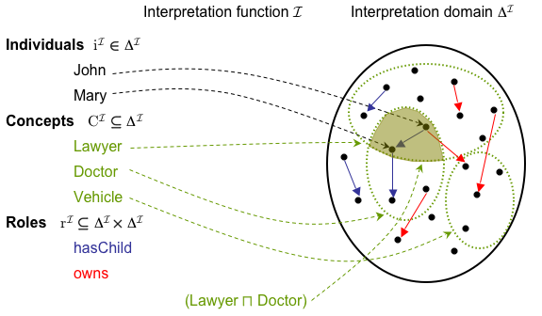
Description Logic Semantics
Semantics given by standard first-order model:

Slide 17
Abox, Tbox, Rbox
Abox: all the fact assertions
Similar to the data of a classical DB
But, inferences can add assertions to Abox
Tbox (Rbox): all the terminological and relationship assertions
Similar to the schema of a classical DB
But, inferences can generate new axioms
Axioms are not just constraints to check, they assert new knowledge

Slide 18
Fact Assertions
Concept assertion: assign a class to an individual
Mother(julia)
Role assertion: asserting a relationship between two individuals
hasChild(julia, john)
Inequality assertion
julia ≉ john
Equality assertion (owl:sameAs)
john ≈ johnny

Slide 19
Terminological Knowledge: Concepts
Concept Inclusion = subclassOf = set inclusion
A ⊑ B : the set of objects denoted by A is a subset of the set of objects denoted by B
Ex: Human ⊑ Animal
∀x Human(x) → Animal(x)
Concept Equivalence = set equality
A ≡ B : two concepts have the same instances
Ex: Person ≡ Human
∀x Human(x) ↔ Person(x)

Slide 20
Terminological Knowledge: Relationships
Role Inclusion = set inclusion (elements are pairs of objects)
Ex: manages ⊑ worksFor⁻
Role composition
brotherOf ∘parentOf ⊑ uncleOf
∀x,y brotherOf(x,y) ^ parentOf(y,z) → uncleOf(x,z)
Role Equivalence = set equivalence
Ex: worksFor ≡ isEmployeeOf
∀x, y worksFor(x,y) ↔ isEmployeeOf(x,y)

Slide 21
Open-world vs Closed-world
Open-World Assumption: cannot conclude some statement x to be false simply because we cannot show x to be true
Typical of logic and knowledge representation languages
Closed-World Assumption: if we cannot prove x, we assume it is false
Typical of databases
Examples:
Question: "Did it rain in Tokyo yesterday?"
Open-world Answer: "I don’t know that it rained, but that’s not enough reason to conclude that it didn’t rain"
Closed-world answer: "I don’t have a record that it rained, so I conclude that it didn’t rain”
Question: ”Does John work at IBM?”
Closed-world : there is no record for John in the employee table, so he doesn’t
Open-world: I don’t know (the database may be incomplete)

Slide 22
Unique-name assumption (UNA)
UNA: When two individuals have different names, they are in fact different individuals
Typical of database systems
This assumption sometimes works (ex. Product codes) and sometimes does not (ex. People)
OWL does not make the unique-name assumption

Slide 23
Description Logics
Classes are defined in terms of other classes/relations
Powerful inference algorithms:
Subsumption: is class A a subclass of class B given their definitions?
Recognition: is x an instance of class A?
Classification: automatic reorganization of class hierarchy based on definitions of classes

Slide 24
Classification: Defining an Ontology
animal
mammal
sick animal
has
disease
“A sick animal has a disease”
dog
rabies
“A dog is a mammal”
“rabies is a disease”

Slide 25
Classification: Defining a “rabid dog”
animal
mammal
sick animal
has
disease
dog
rabies
has
rabid dog

Slide 26
Classification: Classifier Infers “sick animal”
animal
mammal
sick animal
has
disease
dog
rabies
has
rabid dog

Slide 27
Classification: Defining “rabid animal”
animal
mammal
sick animal
has
disease
dog
rabies
has
has
rabid dog
rabid animal

Slide 28
Classification: Concept Placed in Hierarchy
animal
mammal
sick animal
has
disease
rabid animal
has
dog
rabies
has
rabid dog

Slide 29
OWL2 Description Logic
OWL DL corresponds to a well-studied decidable description logic SROIQ(D)
Reasoning is 2NExpTime-complete (*)
Implemented reasoners: Fact++, Hermit, Pellet, RacerPro
Lose full compatibility with RDF
Not every RDF document is a legal OWL DL document.
Every legal OWL DL document is a legal RDF document.
(It’s OK, just avoids the messy parts of RDF/S)
(*) Yevgeny Kazakov. RIQ and SROIQ are Harder than SHOIQ. KR 2018. https://www.cs.ox.ac.uk/files/362/Kazakov_KR08_RIQ_SROIQ.pdf

Slide 30
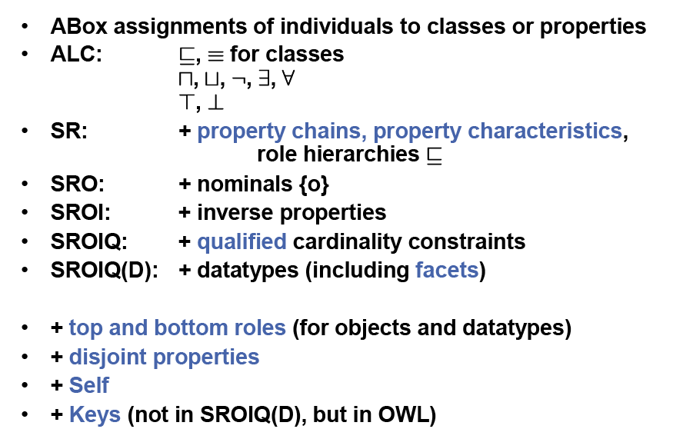
OWL2 DL Summary
based on slide from Pascal Hitzler

Slide 31
OWL Classes
Classes are defined using owl:Class
owl:Class is a subclass of rdfs:Class
owl:Thing is the most general class, which contains everything (T)
~ True
owl:Nothing is the empty class (⊥)
~ False

Slide 32
OWL Properties
Object properties: relate objects to other objects
Ex: isTaughtBy, supervises, …
<owl:ObjectProperty rdf:ID=“teaches">
<rdfs:domain rdf:resource="#teacher"/>
<rdfs:range rdf:resource= "#course"/>
<owl:inverseOf rdf:resource="#isTaughtBy"/>
</owl:ObjectProperty>
Datatype properties: relate objects to data values (XML Schema datatypes)
Ex: phone, title, age, …
<owl:DatatypeProperty rdf:ID="age">
<rdfs:range rdf:resource=
"http://www.w3.org/2001/XLMSchema#nonNegativeInteger"/>
</owl:DatatypeProperty>
∃teaches.T ⊑ Teacher
T ⊑ ∀teaches.Course

Slide 33
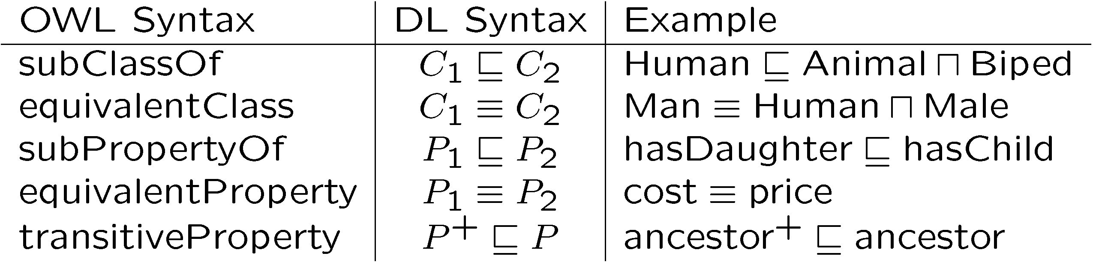
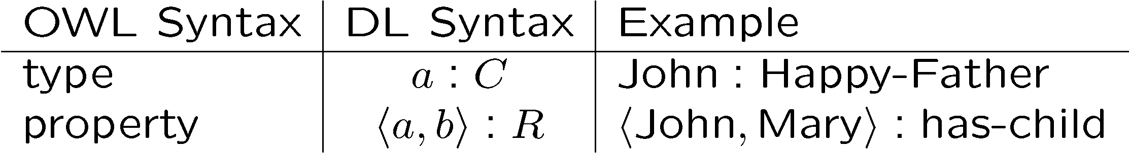
Ontology Axioms
rdfs:
owl:
rdfs:
owl:
owl:
rdf:
owl:ObjectProperty
owl:DatatypeProperty

Slide 34
Class Definitions
In description logics and OWL, classes can be:
Primitive: just a name for a set of objects
Defined: logical formula using class constructors
Concept/Role constructors:
Capture basic representational features
30 year history of knowledge representation
Chosen so that inference (e.g., satisfiability/subsumption) is decidable and, if possible, of low complexity
Two main types of class constructors:
Restrictions on properties
Logical Boolean operators: and, or, not (complement)
Many description logics, depending on choice of concept/role constructors

Slide 35
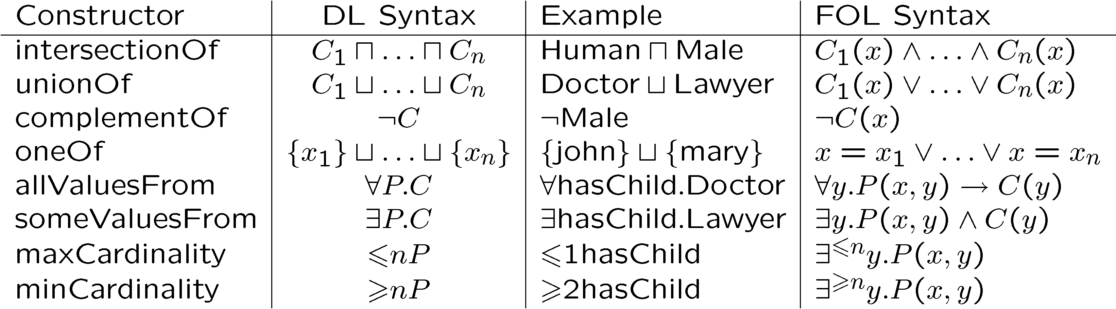
Class/Concept Constructors
C is a concept (class); P is a role (property);
x, y are variables ranging over individuals

Slide 36
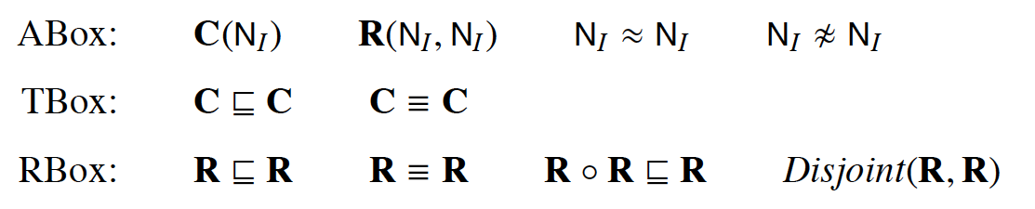
OWL2 is essentially the Description Logic SROIQ
R ::= U | N_{R |}| N _{R-}

Slide 37
OWL Property Restrictions
In OWL we can define a class by restricting the way it participates in a property
A (restriction) class is achieved through an owl:Restriction element, which contains
owl:onProperty element
one or more restriction declarations
Value Restrictions: restrictions on the kinds of values a property may take
owl:someValuesFrom
owl:allValuesFrom
owl:hasValue
Cardinality Restrictions: restrictions on the number of individuals participating in the relation
owl:minCardinality (at least)
owl:maxCardinality (at most)
owl:cardinality (exactly)

Slide 38
owl:someValuesFrom
Qualified existential restriction: ∃teaches.Course
The set of individuals that teach some (at least 1) course
Ex: Teacher ⊑ ∃teaches.Course
<owl:Class rdf:about=”#Teacher">
<rdfs:subClassOf>
<owl:Restriction>
<owl:onProperty rdf:resource="#teaches"/>
<owl:someValuesFrom rdf:resource=“#Course"/>
</owl:Restriction>
</rdfs:subClassOf>
</owl:Class>
38

Slide 39
owl:allValuesFrom
Qualified universal restriction: ∀isTaughtBy.Professor
The set of things that are taught only by professors
Ex: UniversityCourse ⊑ ∀isTaughtBy.Professor
<owl:Class rdf:about="#UniversityCourse">
<rdfs:subClassOf>
<owl:Restriction>
<owl:onProperty rdf:resource="#isTaughtBy"/>
<owl:allValuesFrom rdf:resource="#Professor"/>
</owl:Restriction>
</rdfs:subClassOf>
</owl:Class>

Slide 40
Nominals: owl:hasValue
Nominal = concept that has only one instance
Ex: {Germany} is the concept containing only the individual Germany
Ex: German ⊑ ∃bornIn.{Germany}
A German is an individual born in Germany
<owl:Class rdf:about=”#German">
<rdfs:subClassOf>
<owl:Restriction>
<owl:onProperty rdf:resource="#bornIn"/>
<owl:hasValue rdf:resource= "#Germany"/>
</owl:Restriction>
</rdfs:subClassOf>
</owl:Class>
40

Slide 41
Nominals: Enumerated classes with owl:oneOf
DaysOfTheWeek ≡ {Monday} ⨆ … ⨆ {Sunday}
<owl:Class rdf:ID=“DaysOfTheWeek">
<owl:oneOf rdf:parseType="Collection">
<owl:Thing rdf:about="#Monday"/>
<owl:Thing rdf:about="#Tuesday"/>
<owl:Thing rdf:about="#Wednesday"/>
<owl:Thing rdf:about="#Thursday"/>
<owl:Thing rdf:about="#Friday"/>
<owl:Thing rdf:about="#Saturday"/>
<owl:Thing rdf:about="#Sunday"/>
</owl:oneOf>
</owl:Class>

Slide 42
Cardinality Restrictions (1)
Unqualified Cardinality constructor: individuals that have some number of values for a role
Ex: ⩾ 1 hasChild
The set of individuals that have at least one child
Ex: Parent ⊑ ⩾ 1 hasChild
Parents are individuals with at least one child
<owl:Class rdf:about=”#Parent">
<rdfs:subClassOf>
<owl:Restriction>
<owl:onProperty rdf:resource="#hasChild"/>
<owl:minCardinality rdf:datatype="&xsd;nonNegativeInteger"> 1
</owl:minCardinality>
</owl:Restriction>
</rdfs:subClassOf>
</owl:Class>
Note: ⩾ 1 r implies ∃r

Slide 43
Cardinality Restrictions (2)
Qualified Cardinality constructor: individuals that have some number of values of a given type for a role
Ex: ⩾ 1 hasChild.Smart
The set of individuals that have at least one child that is smart
Ex: HappyParent ⊑ ⩾ 1 hasChild.Smart
Happy parents are individuals with at least one child that is smart
<owl:Class rdf:about=”#Parent">
<rdfs:subClassOf>
<owl:Restriction>
<owl:onProperty rdf:resource="#hasChild"/>
<owl:minQualifiedCardinality rdf:datatype="&xsd;nonNegativeInteger">
1
</owl:minQualifiedCardinality>
<owl:onClass rdf:resource=“#Smart”/>
</owl:Restriction>
</rdfs:subClassOf>
</owl:Class>

Slide 44
Local reflexivity: Self
Individuals related to themselves through a role
∃R.Self {x | ⟨x, x⟩ ∈ R^{Ι} }
<owl:Class rdf:about="NarcisticPerson”>
<owl:equivalentClass>
<owl:Restriction>
<owl:onProperty rdf:resource="loves"/>
<owl:hasSelf rdf:datatype=”&xsd;#boolean"> true </owl:hasSelf>
</owl:Restriction>
</owl:equivalentClass>
</owl:Class>

Slide 45
Boolean Operators: Conjunction (Intersection)
FacultyInCS ≡ Faculty ⨅ ∃belongsTo.{CSDepartment}
<owl:Class rdf:ID=“FacultyInCS">
<owl:equivalentClass>
<owl:intersectionOf rdf:parseType="Collection">
<owl:Class rdf:about=”#Faculty"/>
<owl:Restriction>
<owl:onProperty rdf:resource="#belongsTo"/>
<owl:hasValue rdf:resource="#CSDepartment"/>
</owl:Restriction>
</owl:intersectionOf>
</owl:equivalentClass>
</owl:Class>

Slide 46
Boolean Operators: Disjunction (Union)
UniversityPeople ≡ Faculty ⨆ Staff ⨆ Student
<owl:Class rdf:ID="UniversityPeople">
<owl:equivalentClass>
<owl:unionOf rdf:parseType="Collection">
<owl:Class rdf:about=”#Faculty"/>
<owl:Class rdf:about=”#Staff"/>
<owl:Class rdf:about=”#Student"/>
</owl:unionOf>
<owl:equivalentClass>
</owl:Class>

Slide 47
Boolean Operators: Negation (Complement)
<owl:Class rdf:about=”#Vegetarian">
<rdfs:subClassOf>
<owl:Restriction>
<owl:complementOf rdf:resource=”#Carnivorous"/>
</owl:Restriction>
</rdfs:subClassOf>
</owl:Class>
<owl:Class rdf:about=”#Course">
<rdfs:subClassOf>
<owl:Restriction>
<owl:complementOf rdf:resource=”#Professor"/>
</owl:Restriction>
</rdfs:subClassOf>
</owl:Class>
Vegetarian ⊑ ¬ Carnivorous
Course ⊑ ¬ Professor

Slide 48
Property Characteristics
owl:TransitiveProperty
Ex: “has better grade than”, “is ancestor of”
owl:SymmetricProperty
Ex: “has same grade as”, “is sibling of”
owl:FunctionalProperty defines a property that has at most one value for each object
Ex: “age”, “height”, “directSupervisor”
owl:InverseFunctionalProperty defines a property for which two different objects cannot have the same value

Slide 49
Class Equivalence
Faculty ≡ AcademicStaff
<owl:Class rdf:ID=“Faculty">
<owl:equivalentClass rdf:resource=”#AcademicStaff"/>
</owl:Class>

Slide 50
Class Disjointness
Male ⊑ ¬ Female
<owl:Class rdf:about=”#Male”>
<owl:disjointWith rdf:resource=”#Female"/>
</owl:Class>
AssistantProfessor ⊑ ¬ AssociateProfessor
AssistantProfessor ⊑ ¬ Professor
AssociateProfessor ⊑ ¬ Professor
<owl:AllDisjointClasses>
<owl:members rdf:parseType="Collection">
<owl:Class rdf:about=”#AssistantProfessor ">
<owl:Class rdf:about=”#AssociateProfessor">
<owl:Class rdf:about=”#Professor”>
</owl:members>
</owl:AllDisjointClasses>

Slide 51
OWL RDF/XML Exchange Syntax
Person ⨅ ∀hasChild.(Doctor ⨆ ∃hasChild.Doctor))
<owl:Class>
<owl:intersectionOf rdf:parseType=“ collection">
<owl:Class rdf:about="#Person"/>
<owl:Restriction>
<owl:onProperty rdf:resource="#hasChild"/>
<owl:allValuesFrom>
<owl:unionOf rdf:parseType=" collection">
<owl:Class rdf:about="#Doctor"/>
<owl:Restriction>
<owl:onProperty rdf:resource="#hasChild"/>
<owl:someValuesFrom rdf:resource="#Doctor"/>
</owl:Restriction>
</owl:unionOf>
</owl:allValuesFrom>
</owl:Restriction>
</owl:intersectionOf>
</owl:Class>

Slide 52
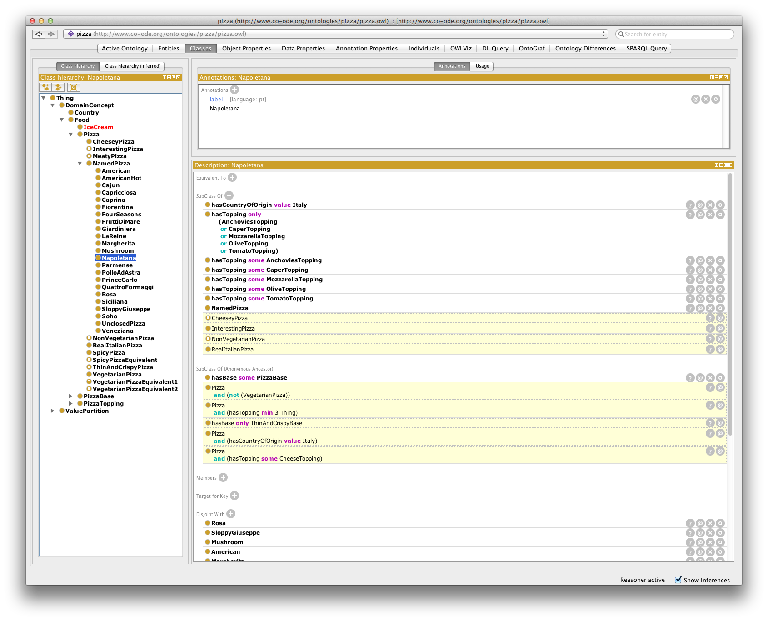
Protégé

Slide 53
Inference Problems
Query Answering
− Find all tuples of individuals satisfying query
based on slide from Pascal Hitzler

Slide 54
Inference Problems: Reduction to Unsatisfiability
based on slide from Pascal Hitzler

Slide 55
Tableaux Inference Algorithms
Reduction to (un)satisfiability.
Idea:
Given knowledge base K
Construct a tree (called Tableau, actually a forest), which represents a model of K.
If attempt fails, K is unsatisfiable.
based on slide from Pascal Hitzler

Slide 56
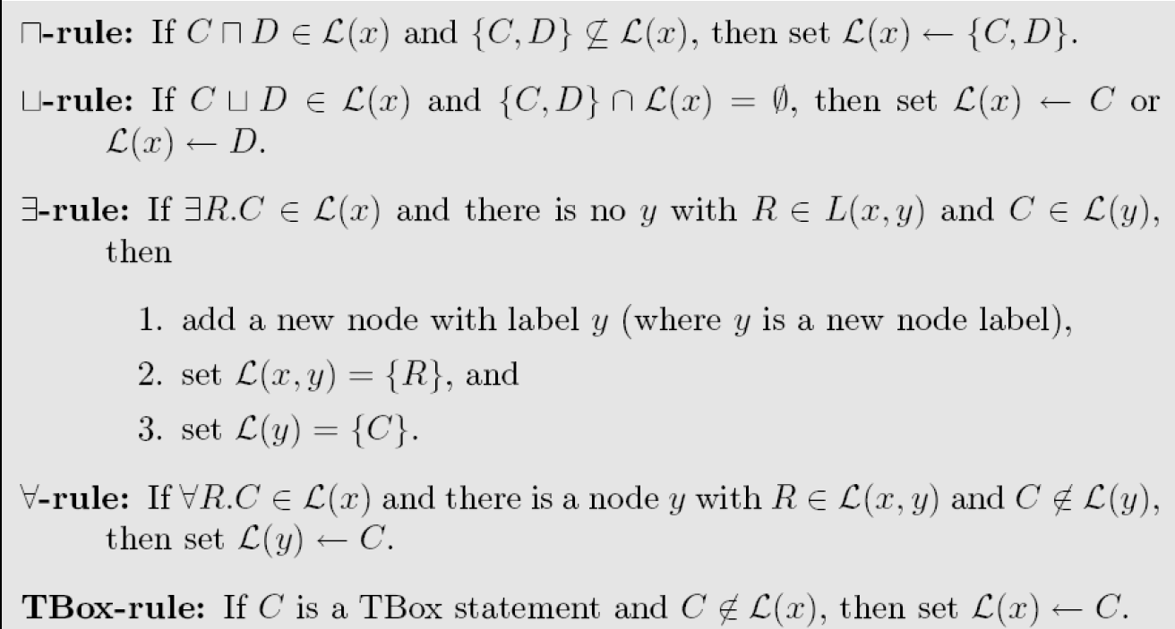
Tableaux rules
based on slide from Pascal Hitzler

Slide 57
Tableaux example 1
KB:
s1: C(a)
s2: C ⊑ ∃R.D
s3: D ⊑ E
Query: Does KB entail (∃R.E)(a) ?
Approach:
Add negation of query: s4: (∀R.¬E)(a)
to KB
2. Show unsatisfiability
C (s1)
∃R.D (s2)
a
R
D (s2)
E (s3)
¬E (s4) Contradiction!
x
based on slide from Pascal Hitzler

Slide 58
Tableaux example 2 Reasoning by Cases
KB:
s1: C(a)
s2: C ⊑ ∃R.D
s3: D ⊑ E ⊔ F
s4: F ⊑ E
Query: Does KB entail (∃R.E)(a) ?
Approach:
Add negation of query: s5:(∀R.¬E)(a)
to KB
2. Show unsatisfiability
C (s1)
∃R.D (s2)
a
D (s2)
¬E (s5)
Choice: D ⊑ E ⊔ F (s3)
1. E Contradiction!
2. F
E (s4) Contradiction!
R
x
based on slide from Pascal Hitzler

Slide 60
Termination
New blocking rules to ensure termination
See Ian Horrocks slides

Slide 61
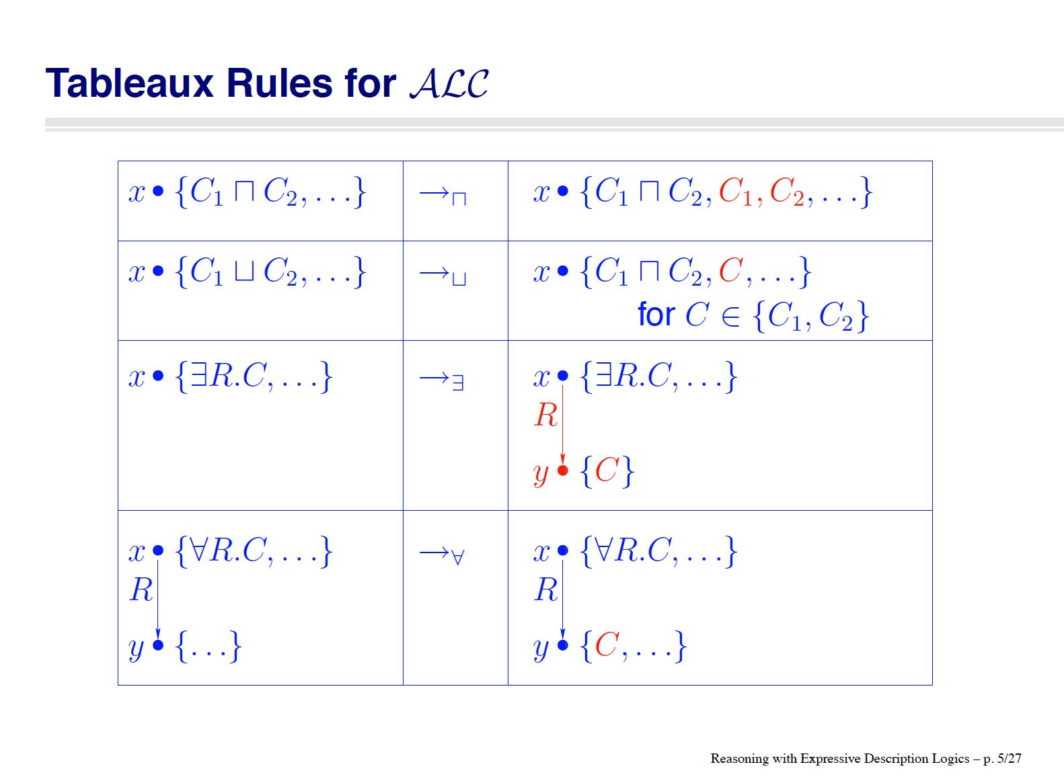
[slide by Ian Horrocks]

Slide 62
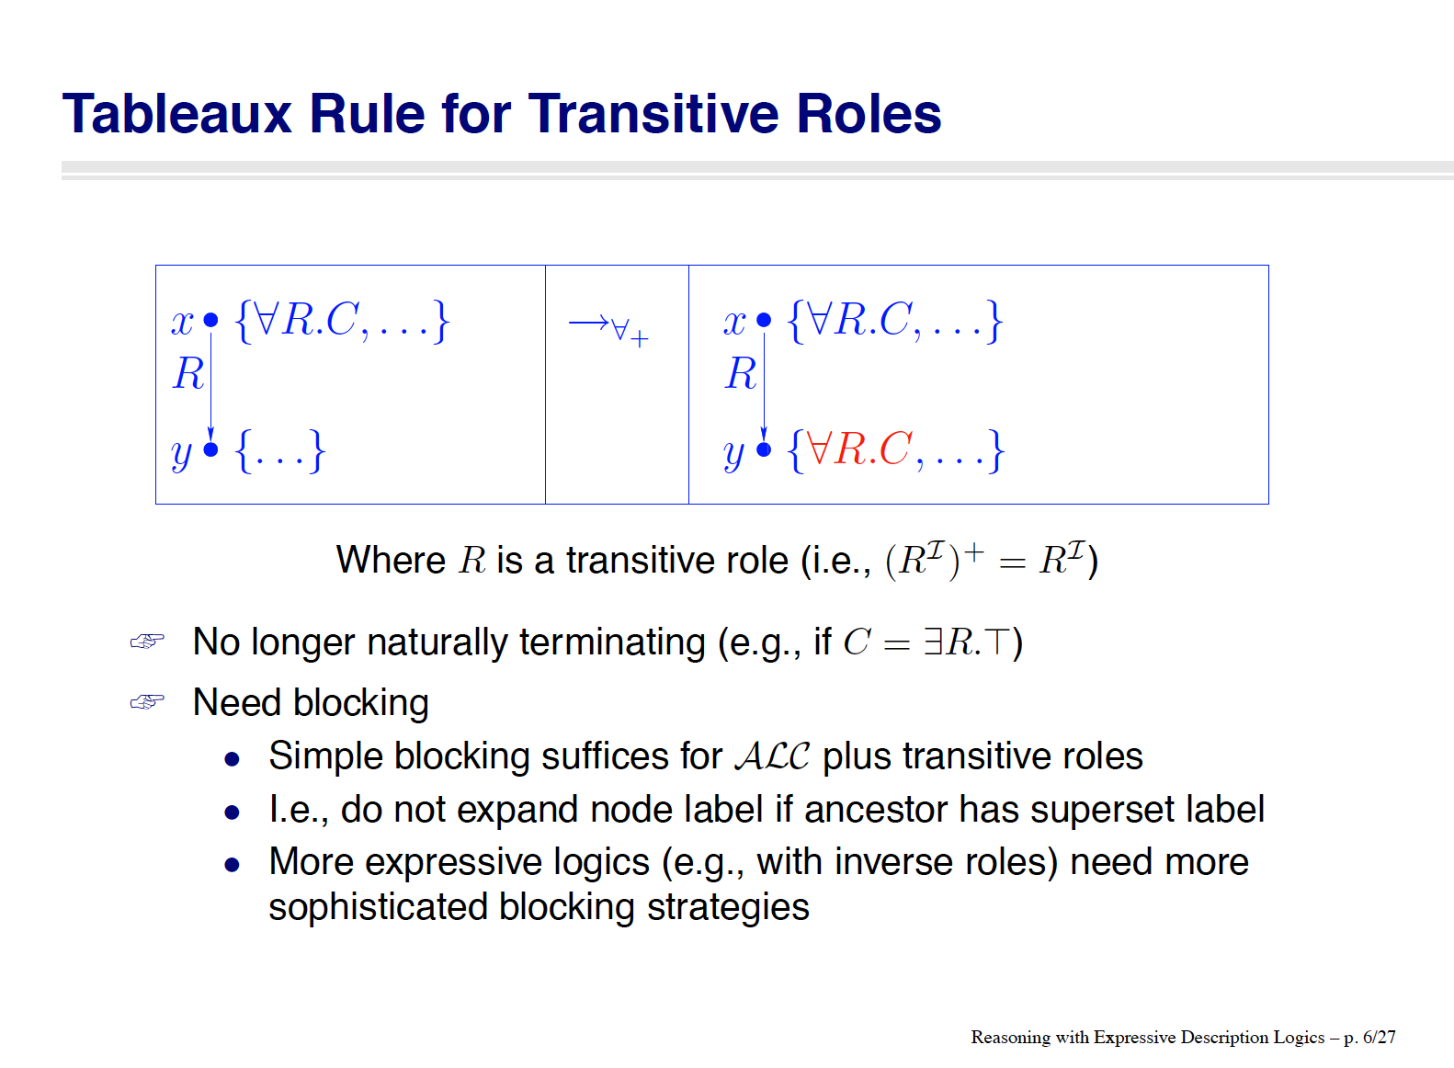
[slide by Ian Horrocks]

Slide 63
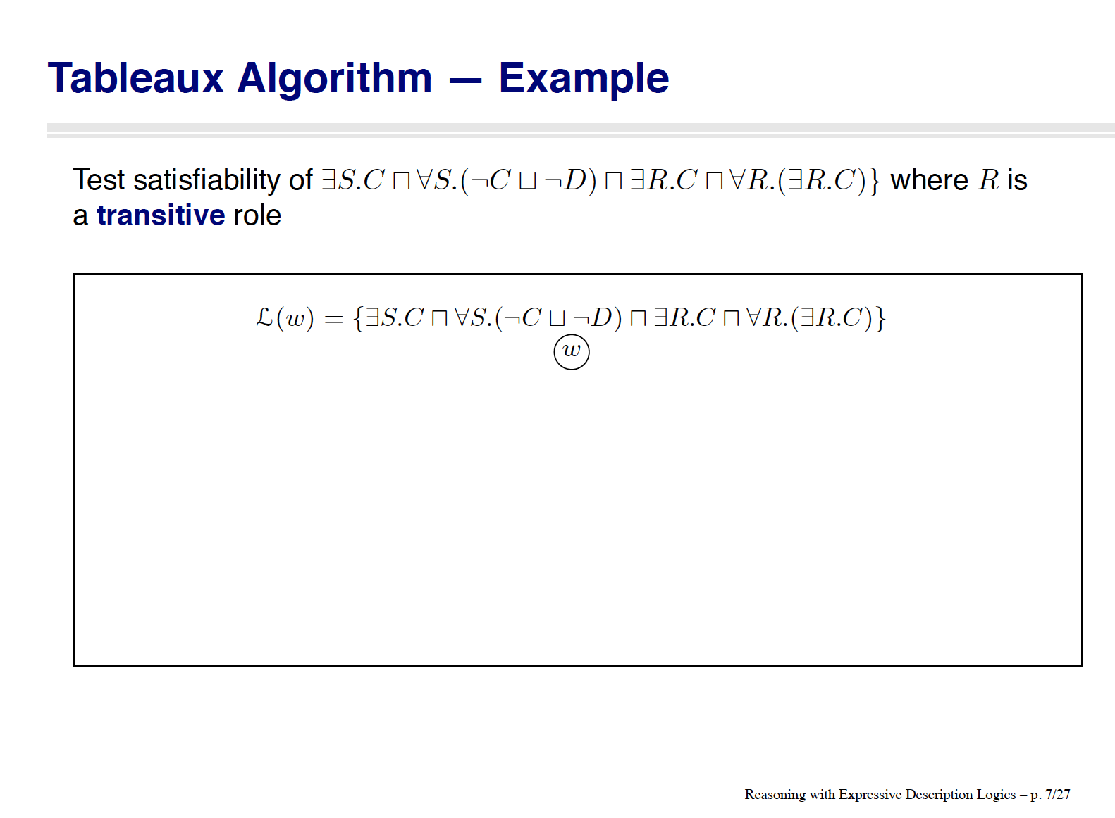
[slide by Ian Horrocks]

Slide 64
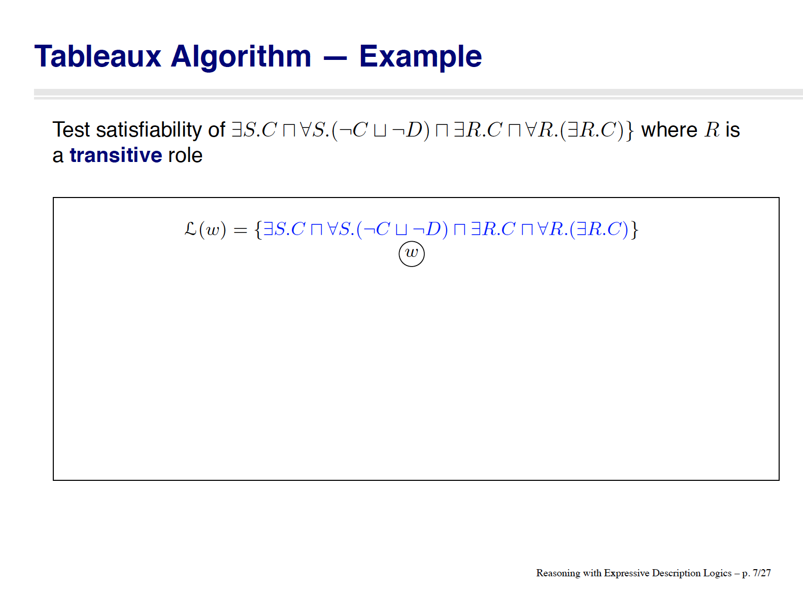
[slide by Ian Horrocks]

Slide 65

[slide by Ian Horrocks]

Slide 66
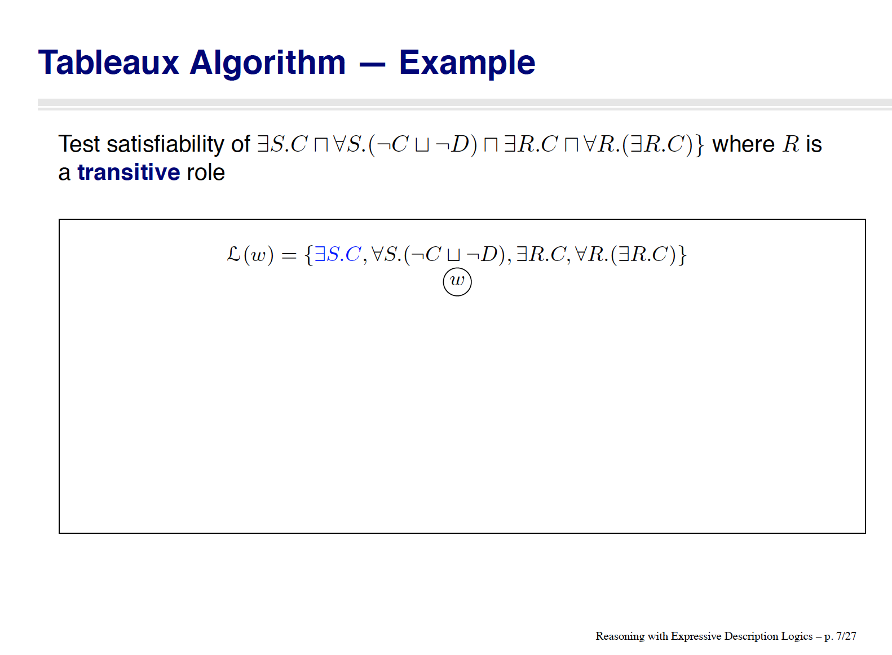
[slide by Ian Horrocks]

Slide 67
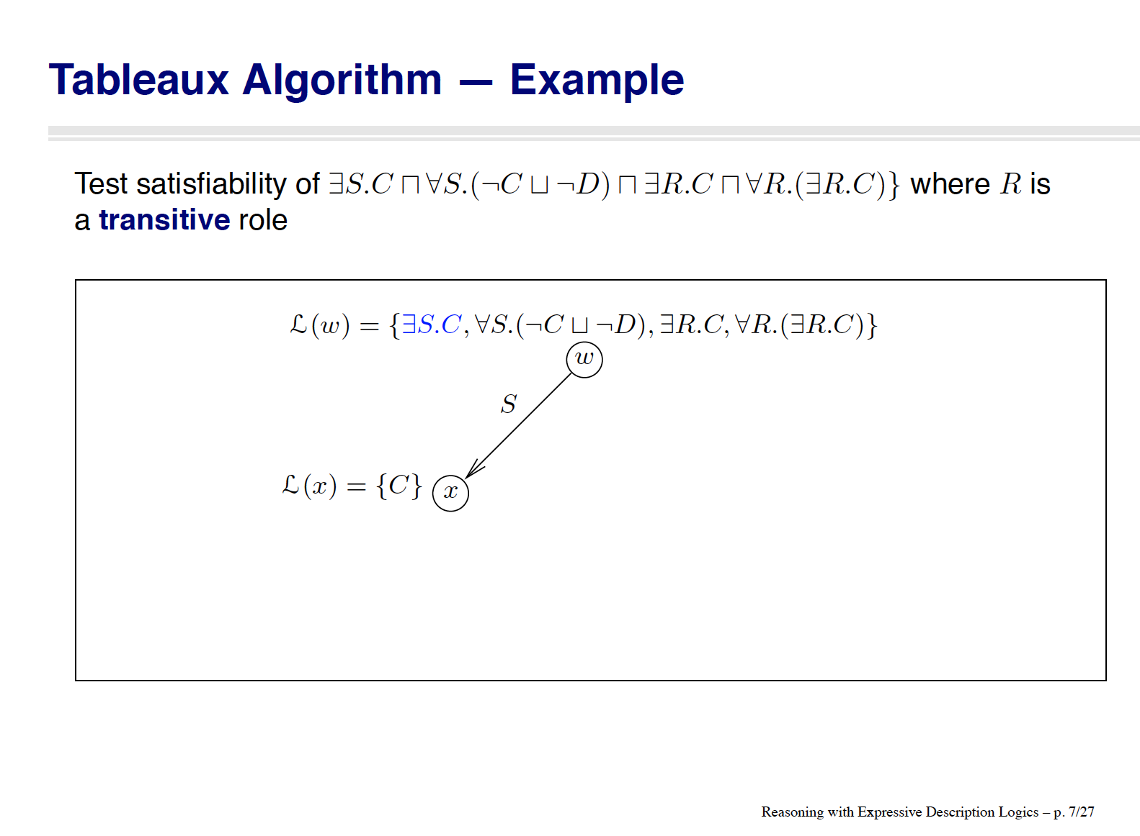
[slide by Ian Horrocks]

Slide 68
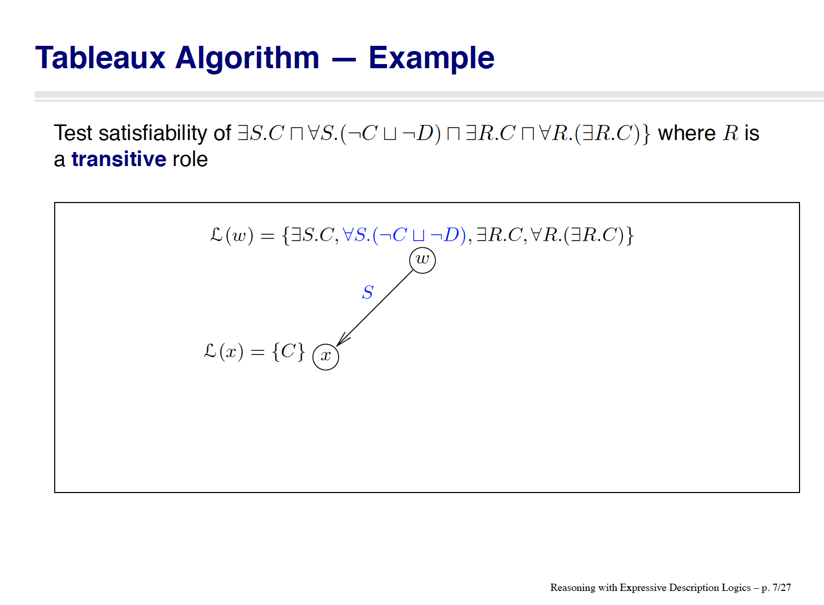
[slide by Ian Horrocks]

Slide 69
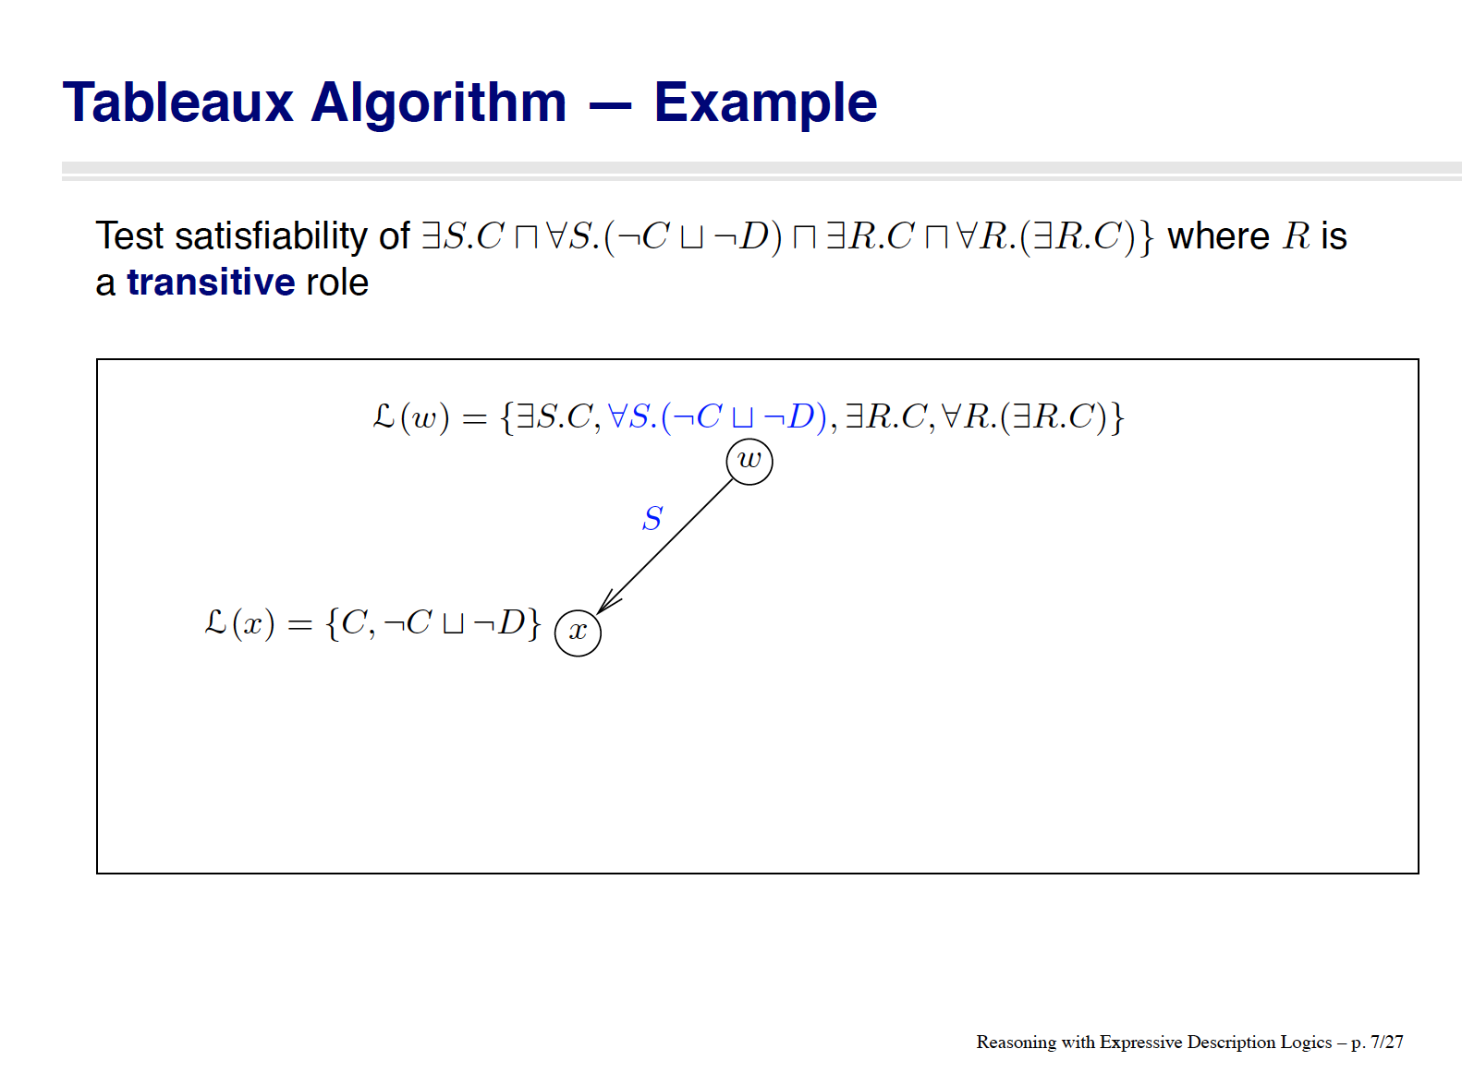
[slide by Ian Horrocks]

Slide 70
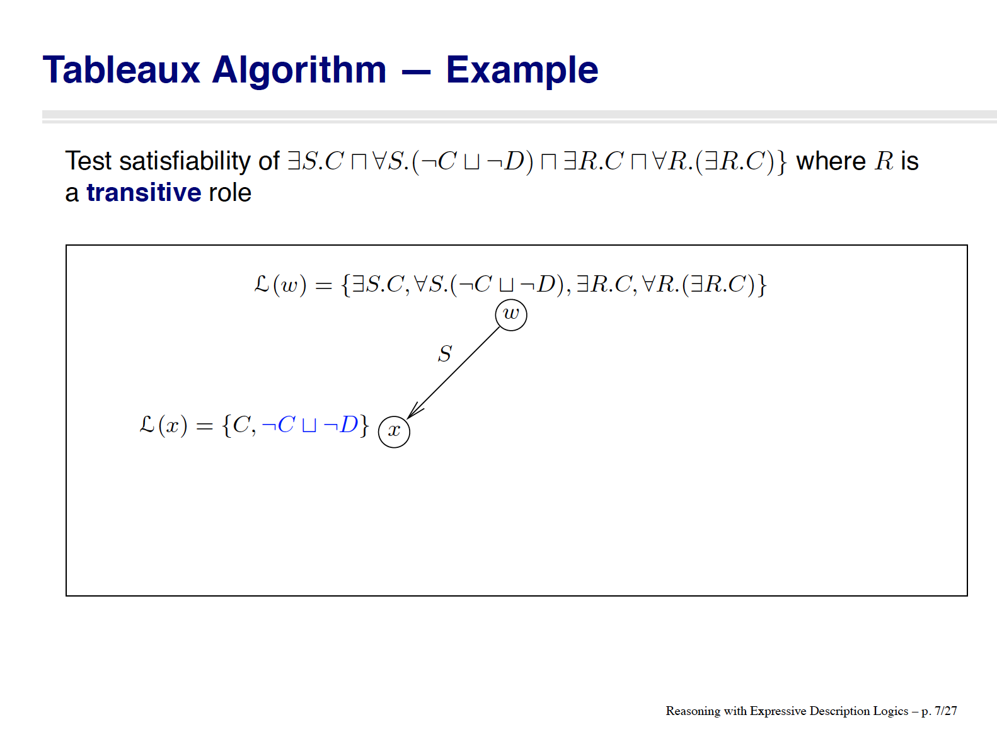
[slide by Ian Horrocks]

Slide 71
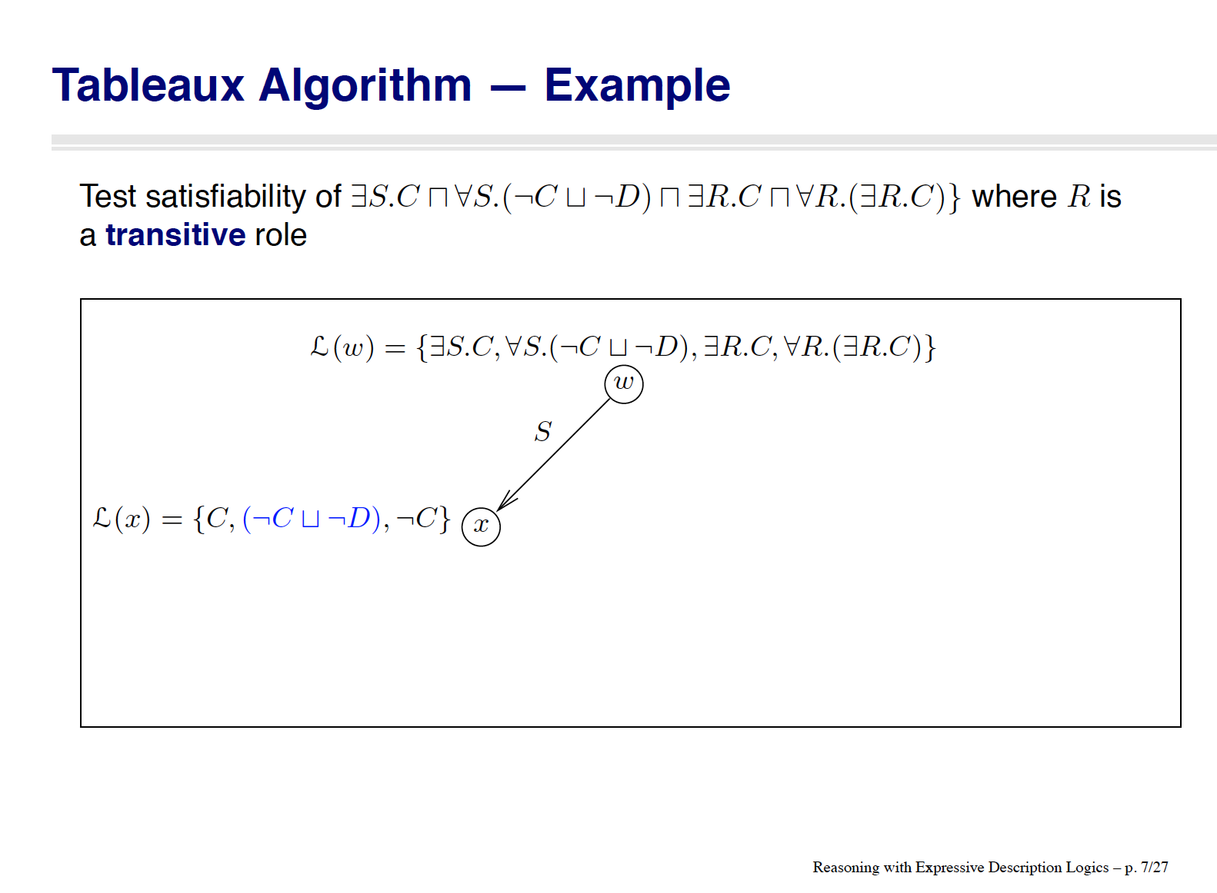
[slide by Ian Horrocks]

Slide 72
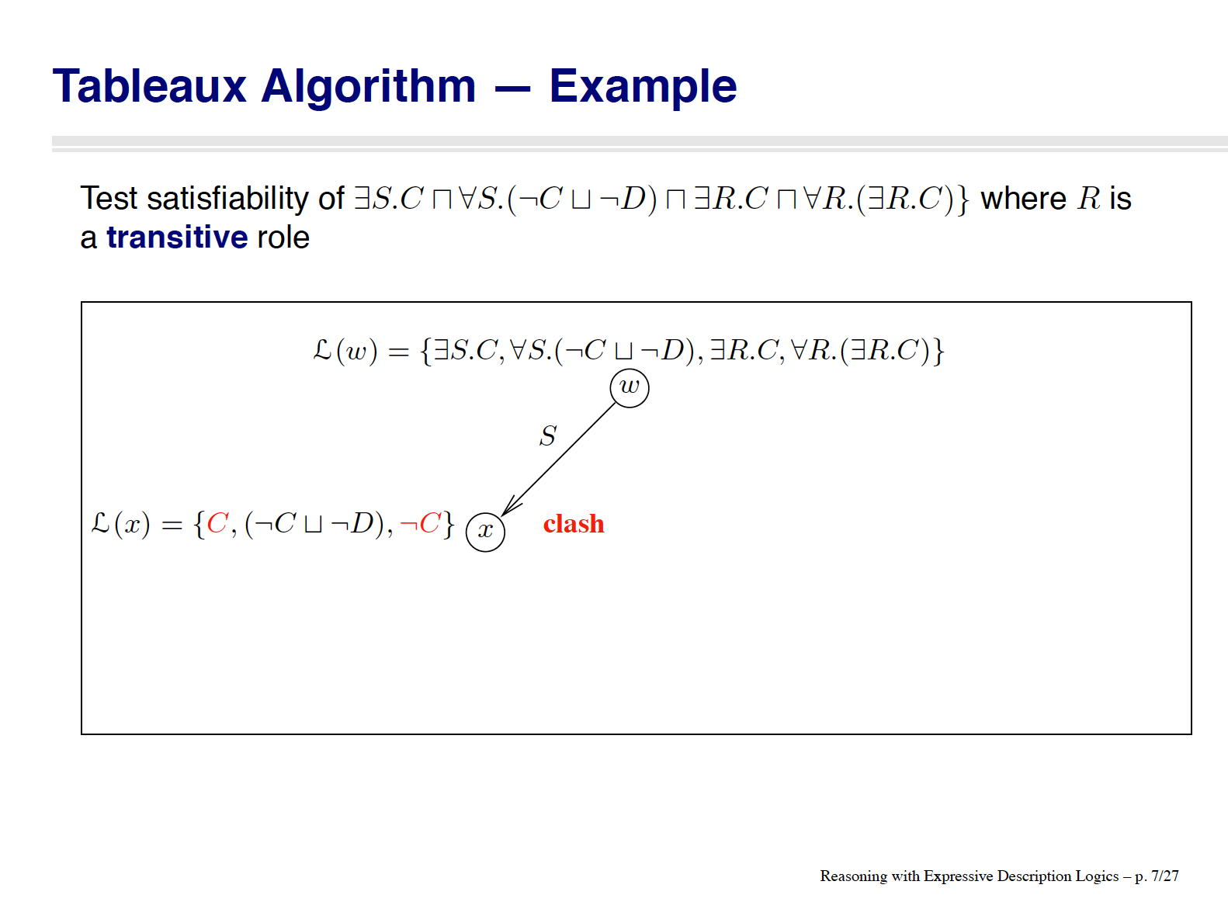
[slide by Ian Horrocks]

Slide 73
[slide by Ian Horrocks]

Slide 74

[slide by Ian Horrocks]

Slide 75
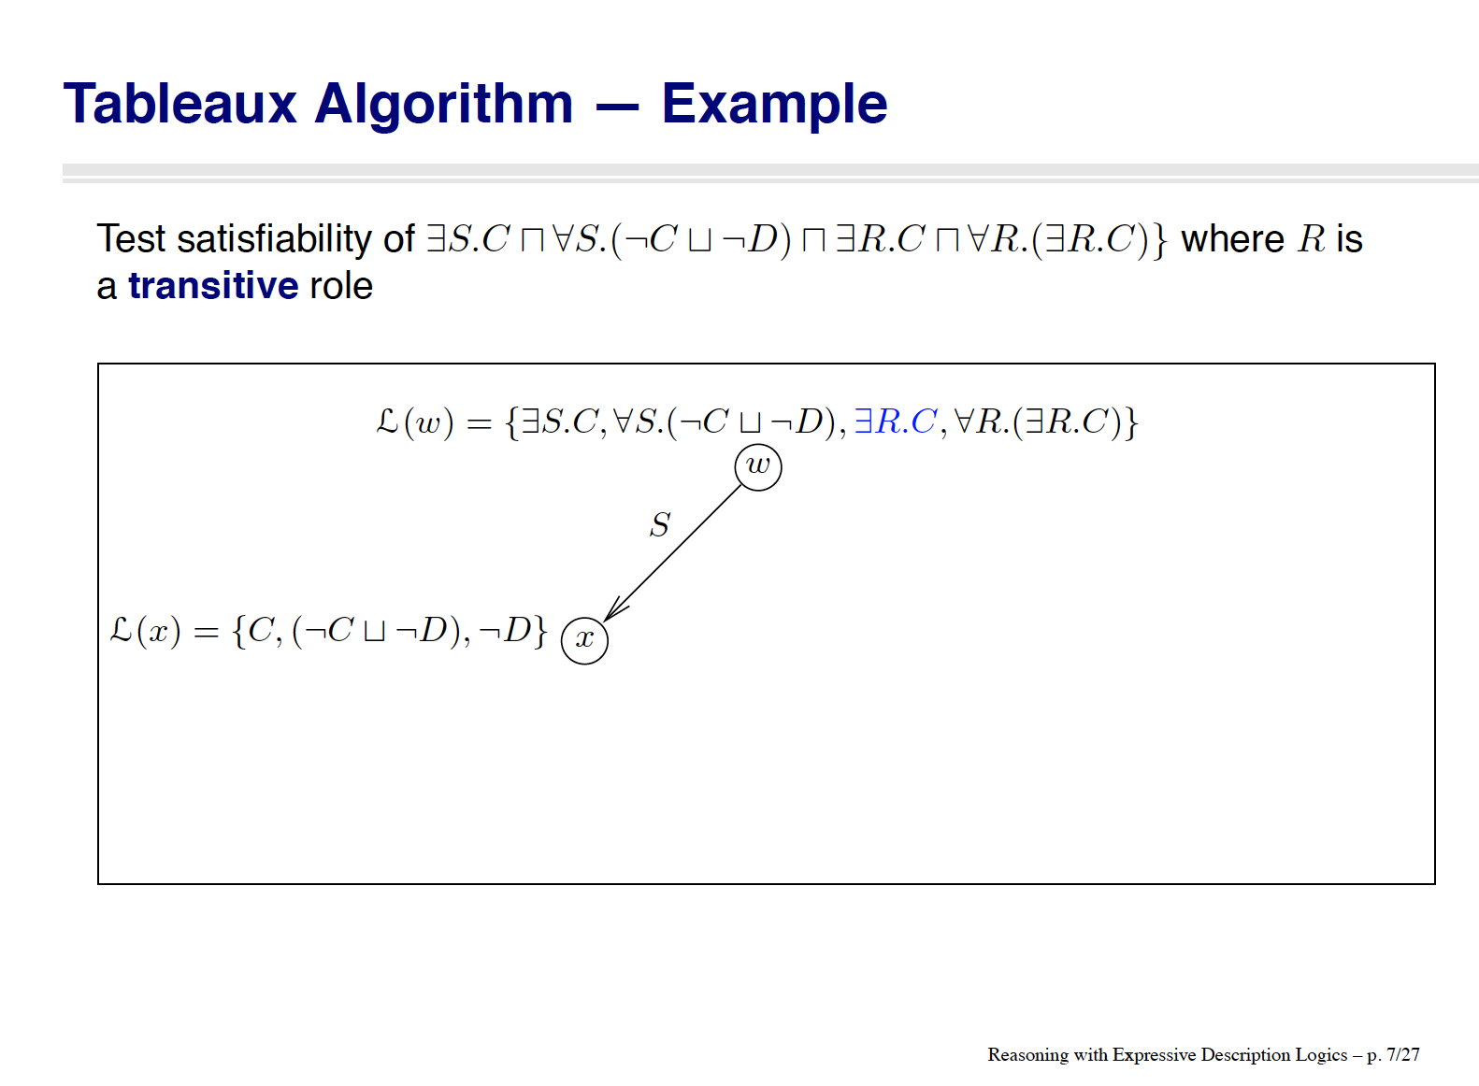
[slide by Ian Horrocks]

Slide 76
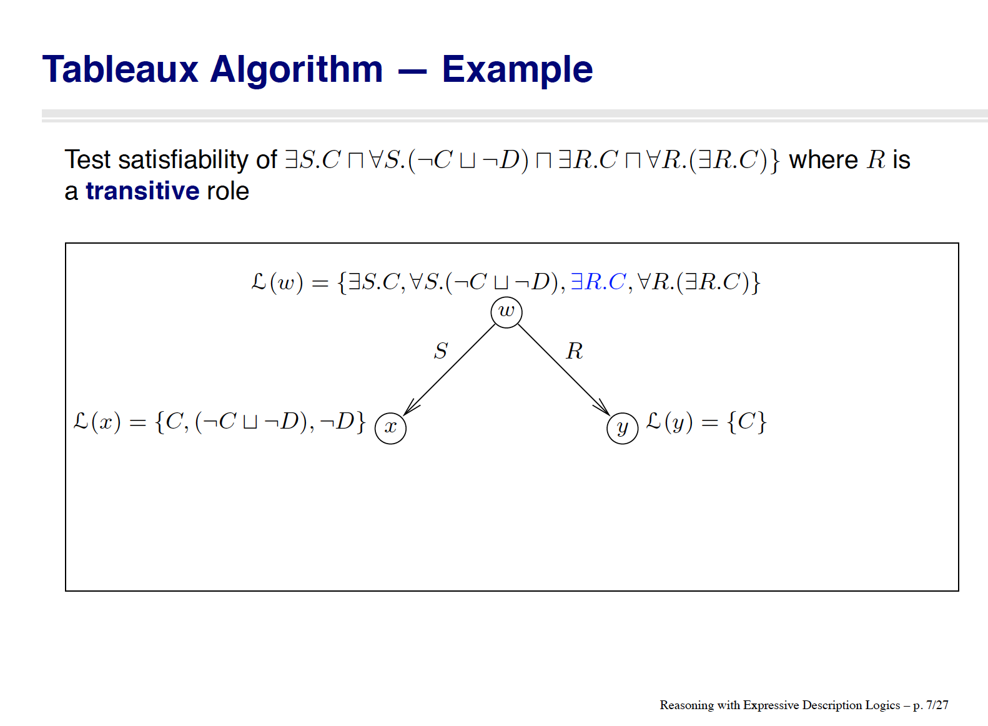
[slide by Ian Horrocks]

Slide 77
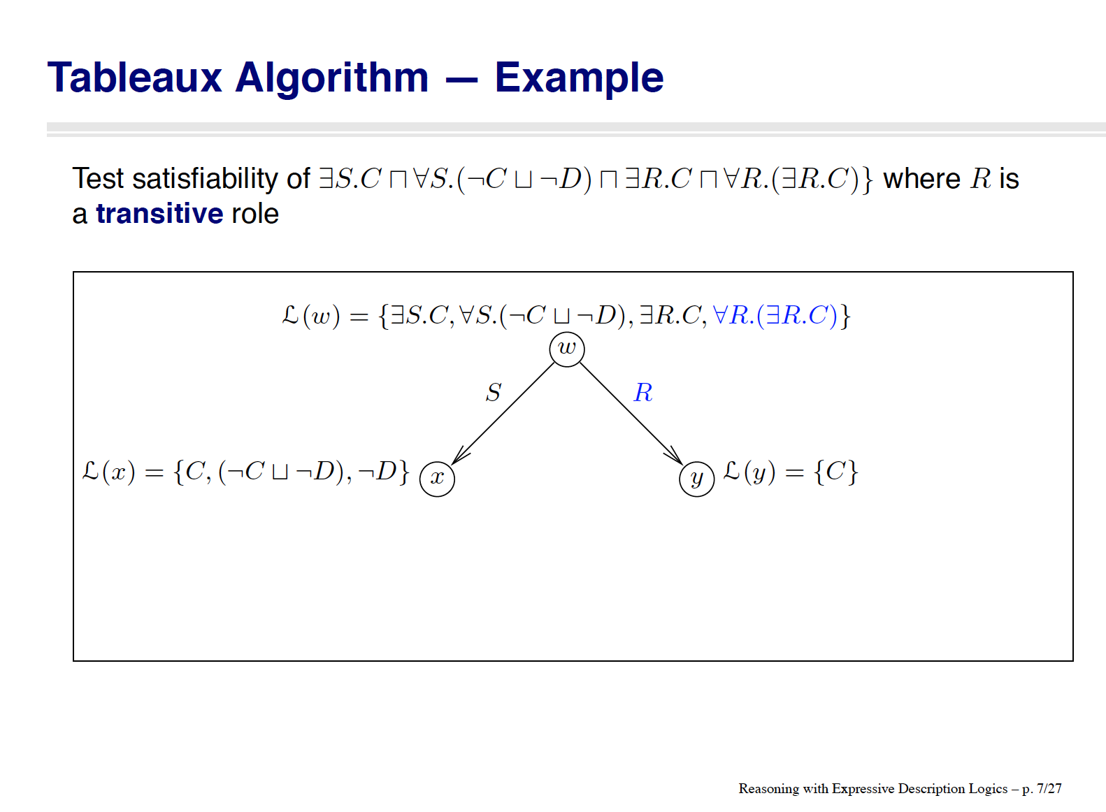
[slide by Ian Horrocks]

Slide 78
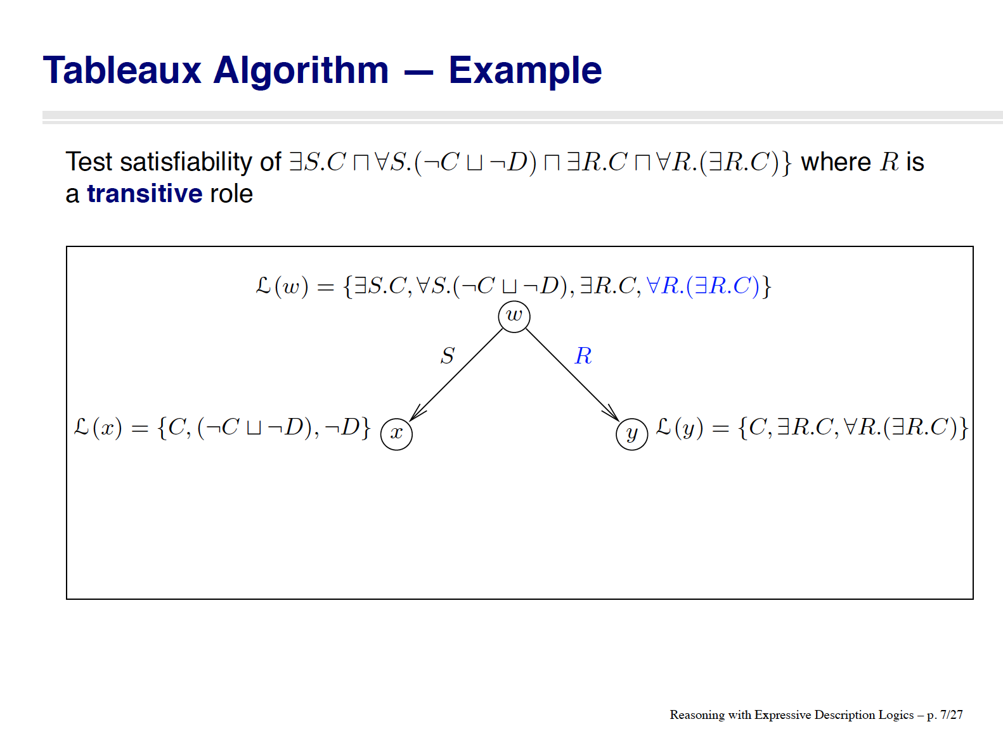

Slide 79
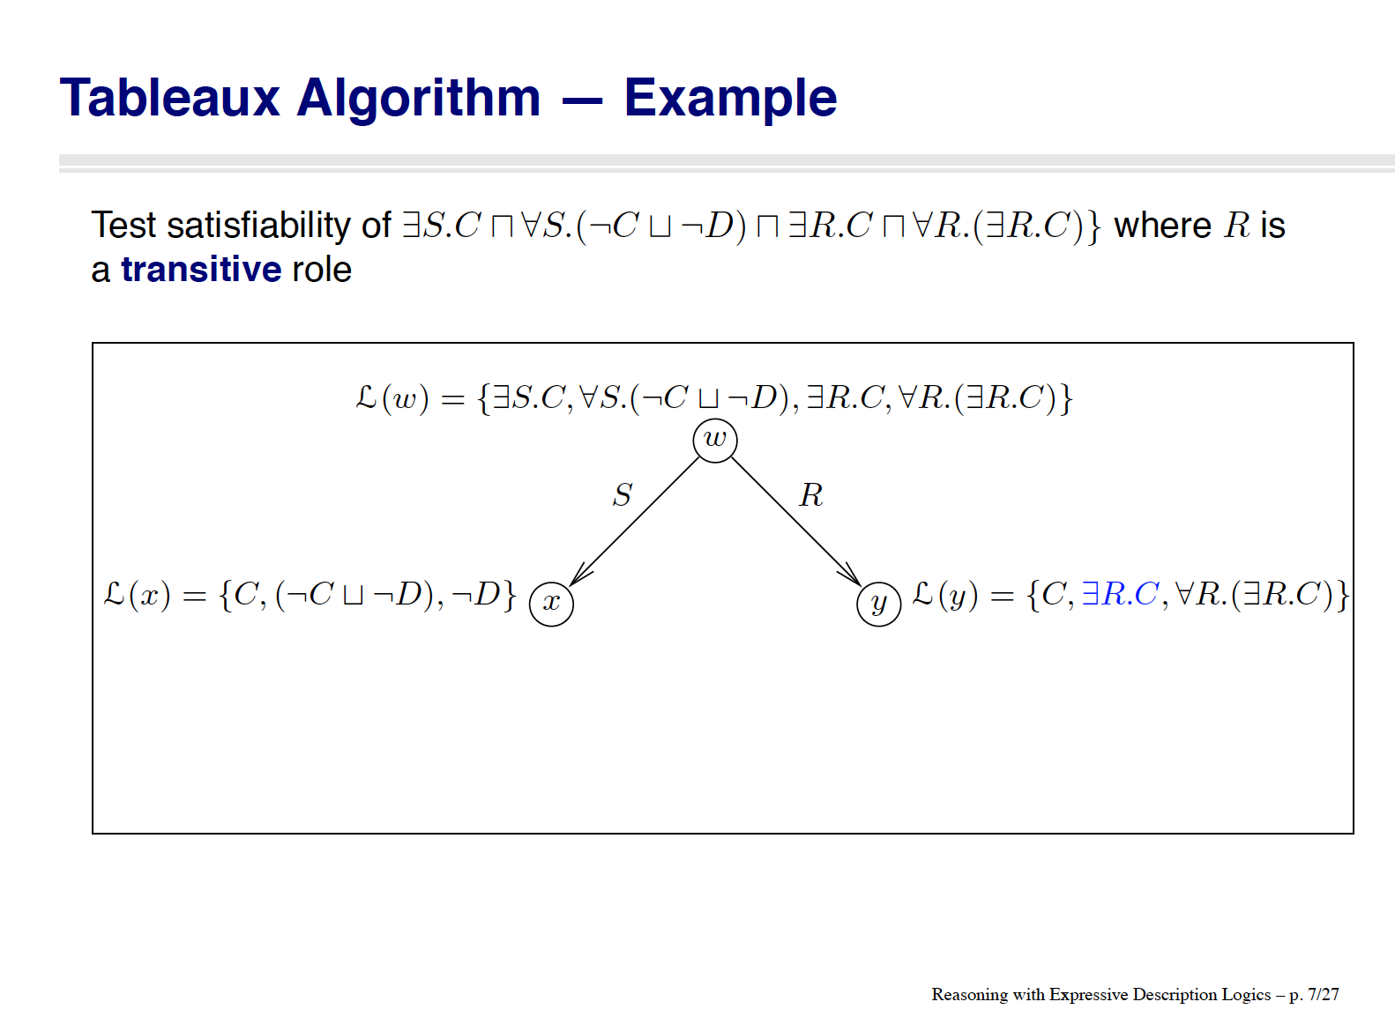
[slide by Ian Horrocks]

Slide 80
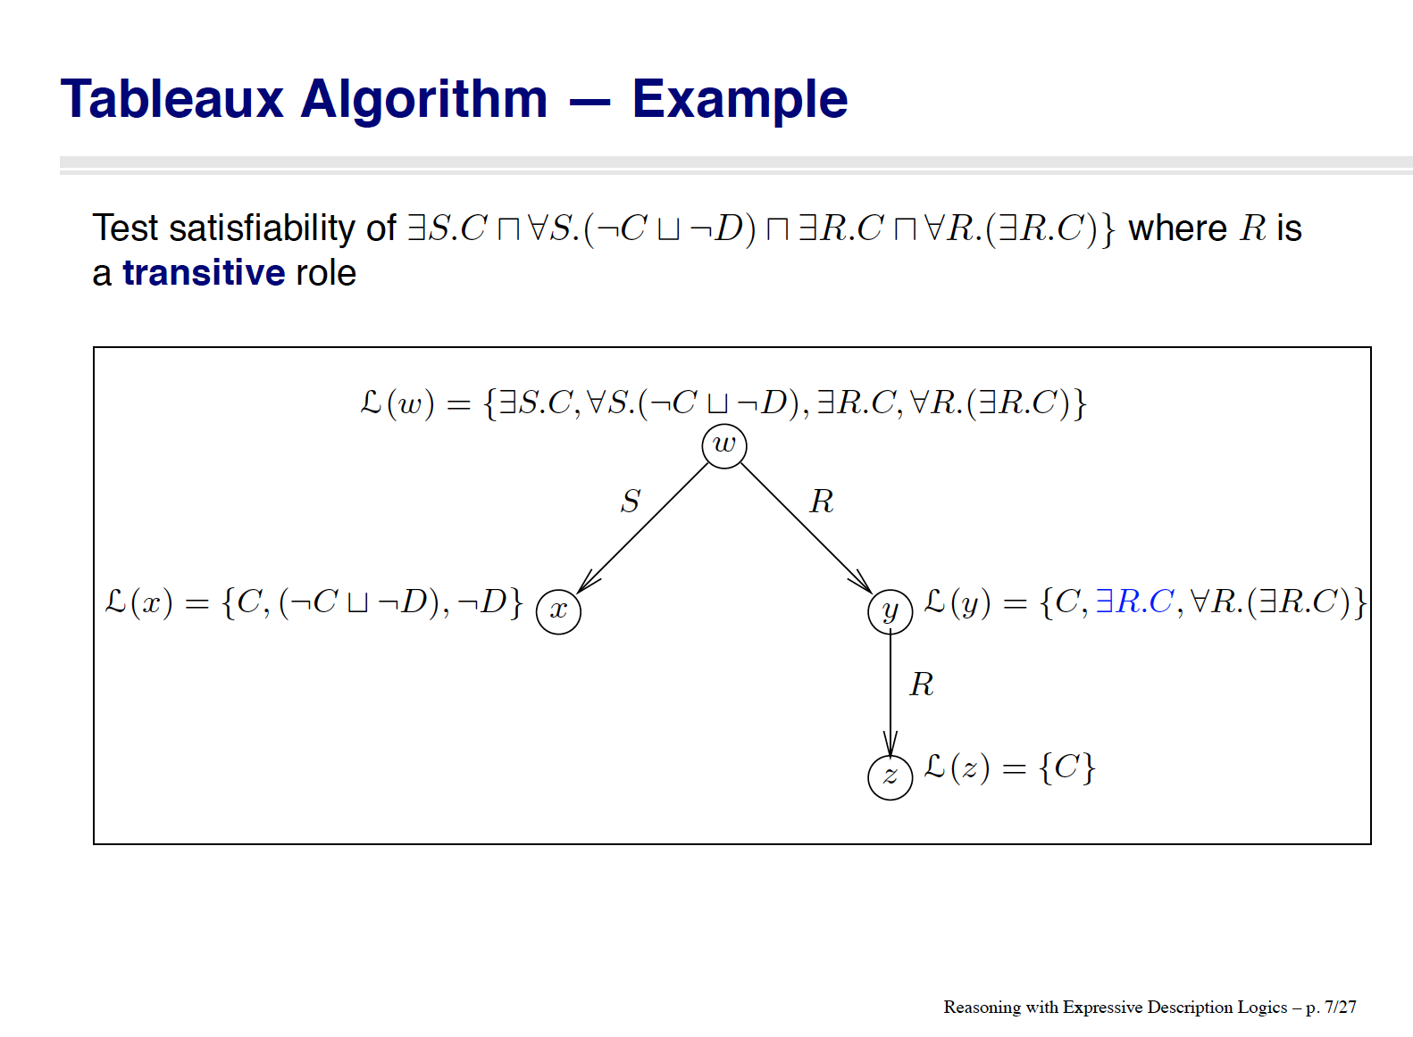
[slide by Ian Horrocks]

Slide 81

[slide by Ian Horrocks]

Slide 82
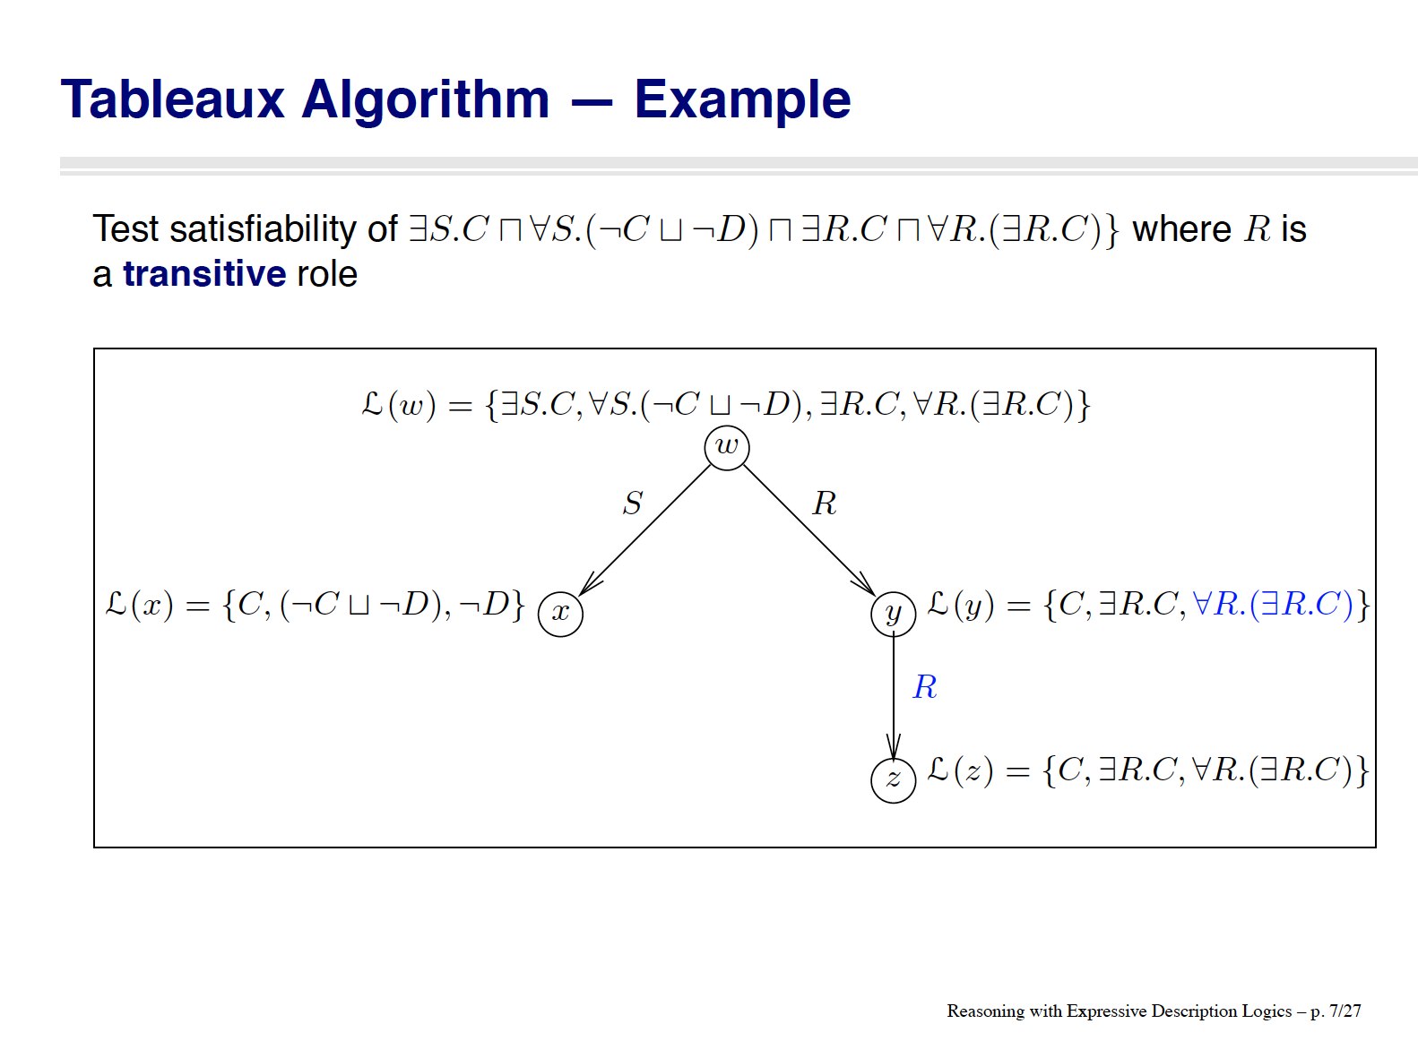
[slide by Ian Horrocks]

Slide 83
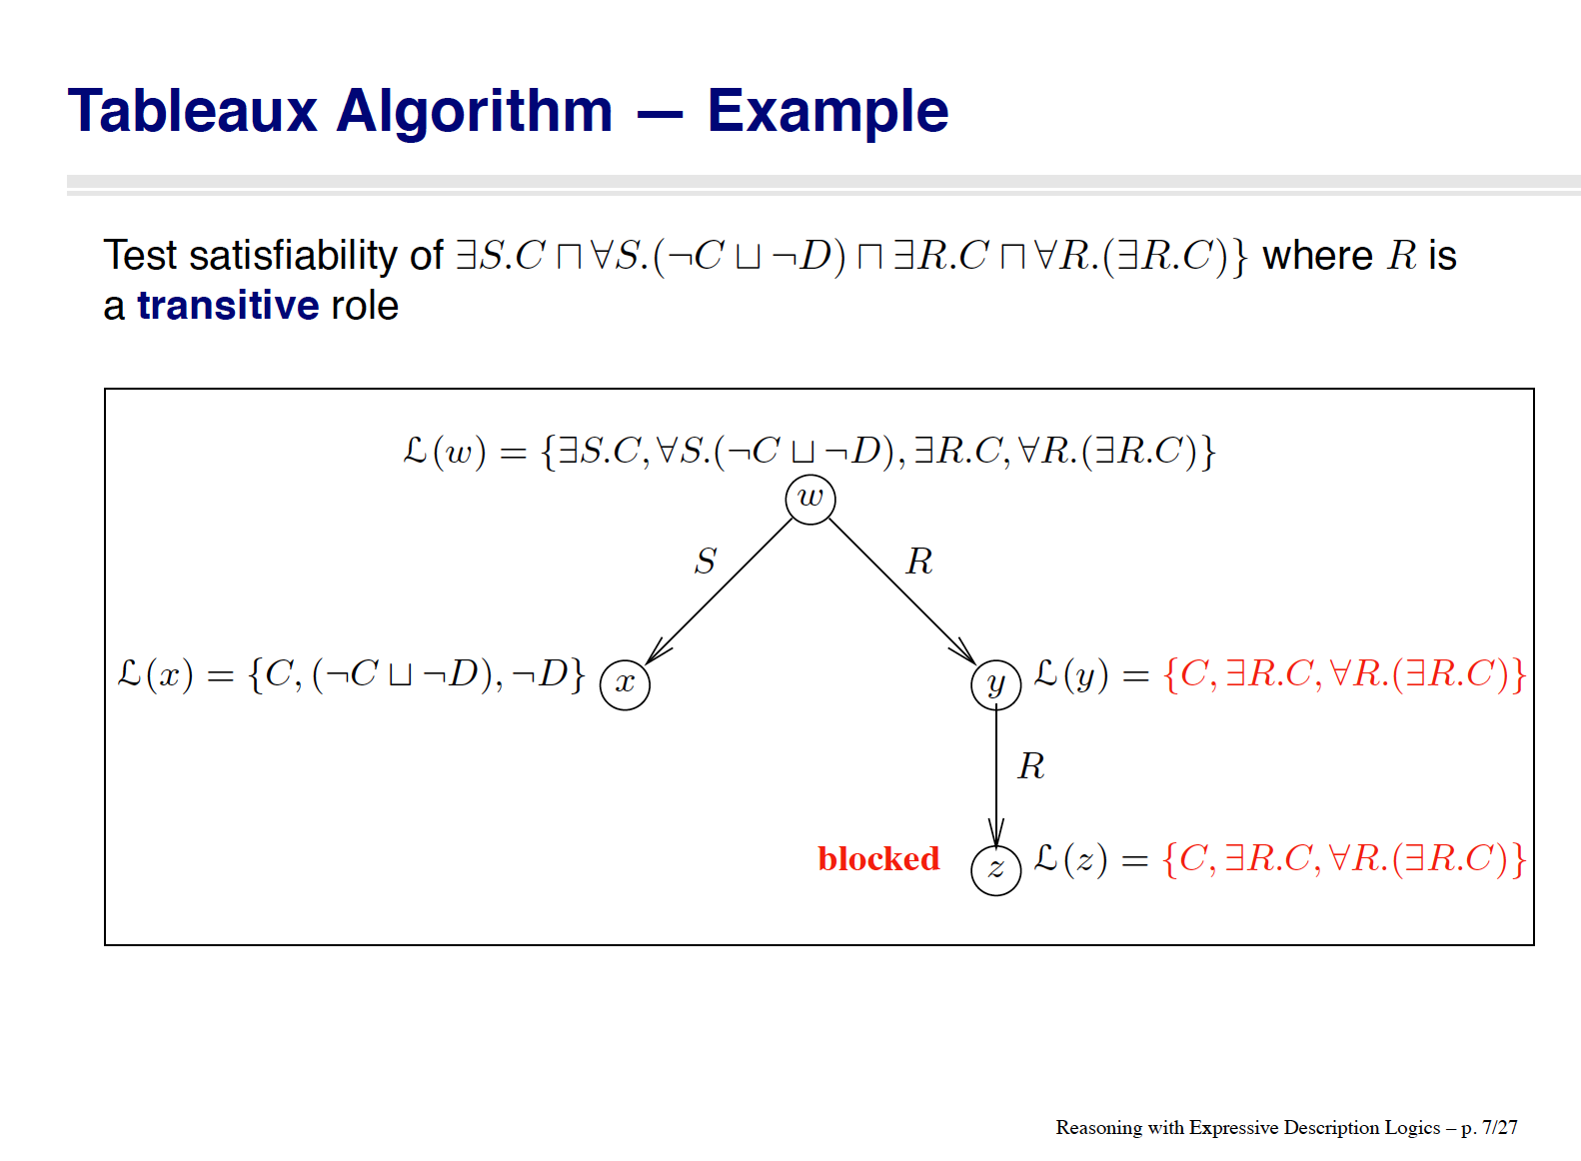
[slide by Ian Horrocks]

Slide 84
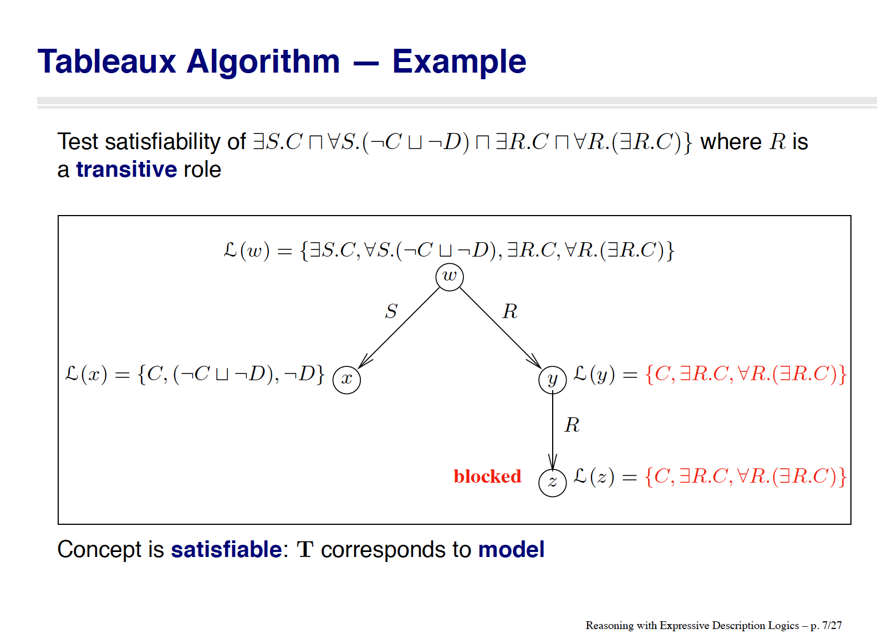
[slide by Ian Horrocks]

Slide 85
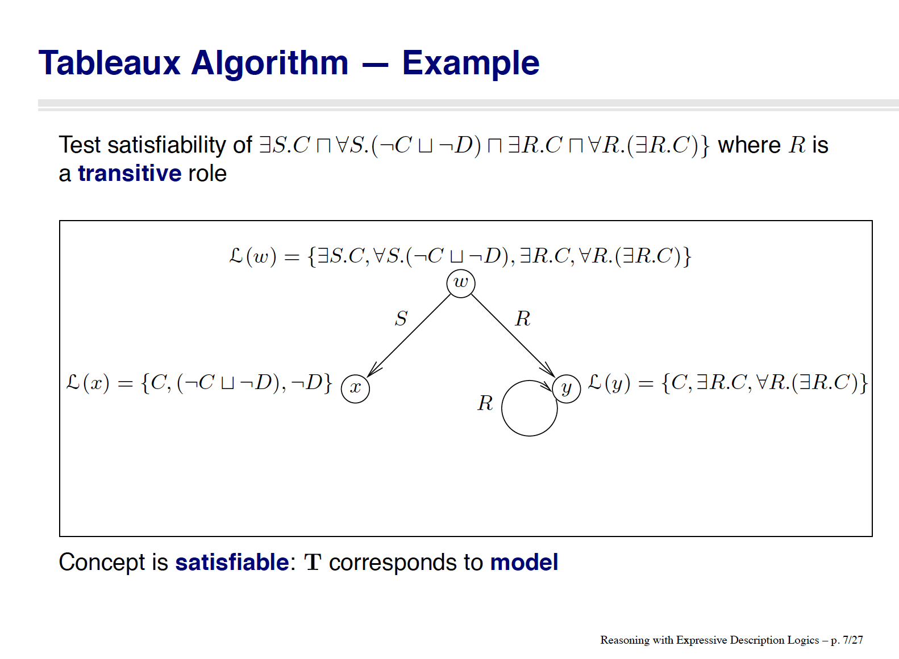
[slide by Ian Horrocks]

Slide 86
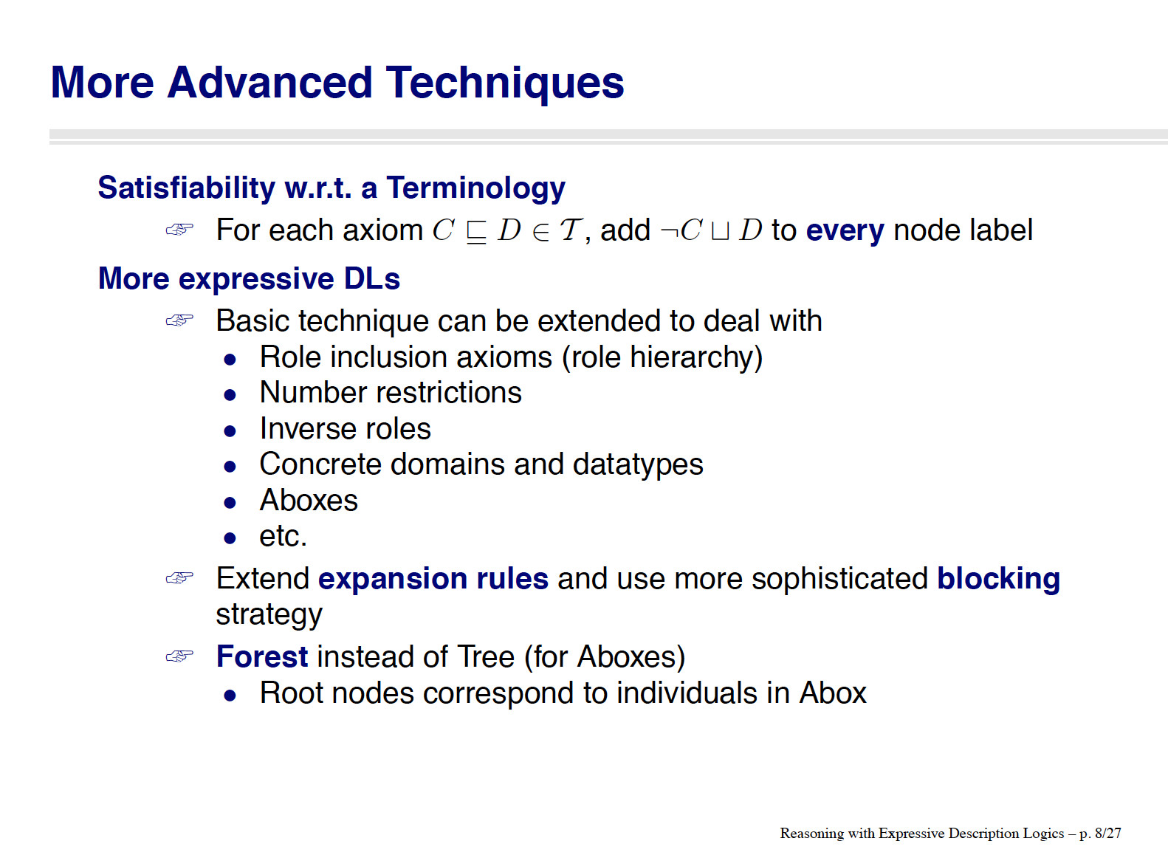
[slide by Ian Horrocks]

Slide 87
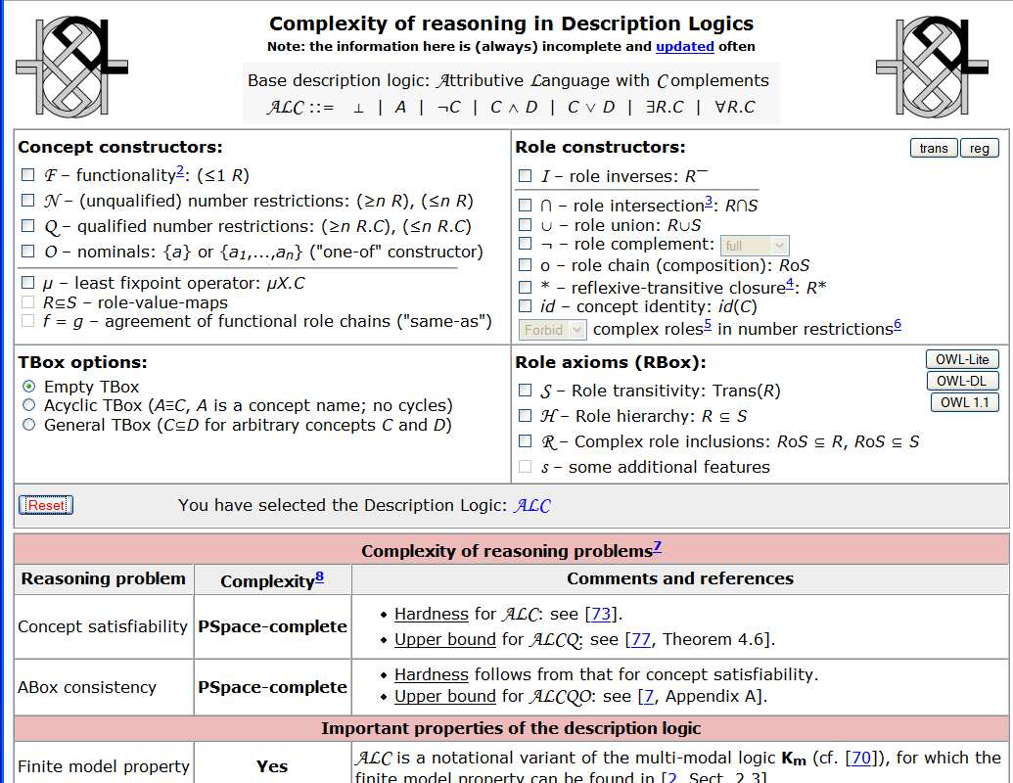
ALC

Slide 88
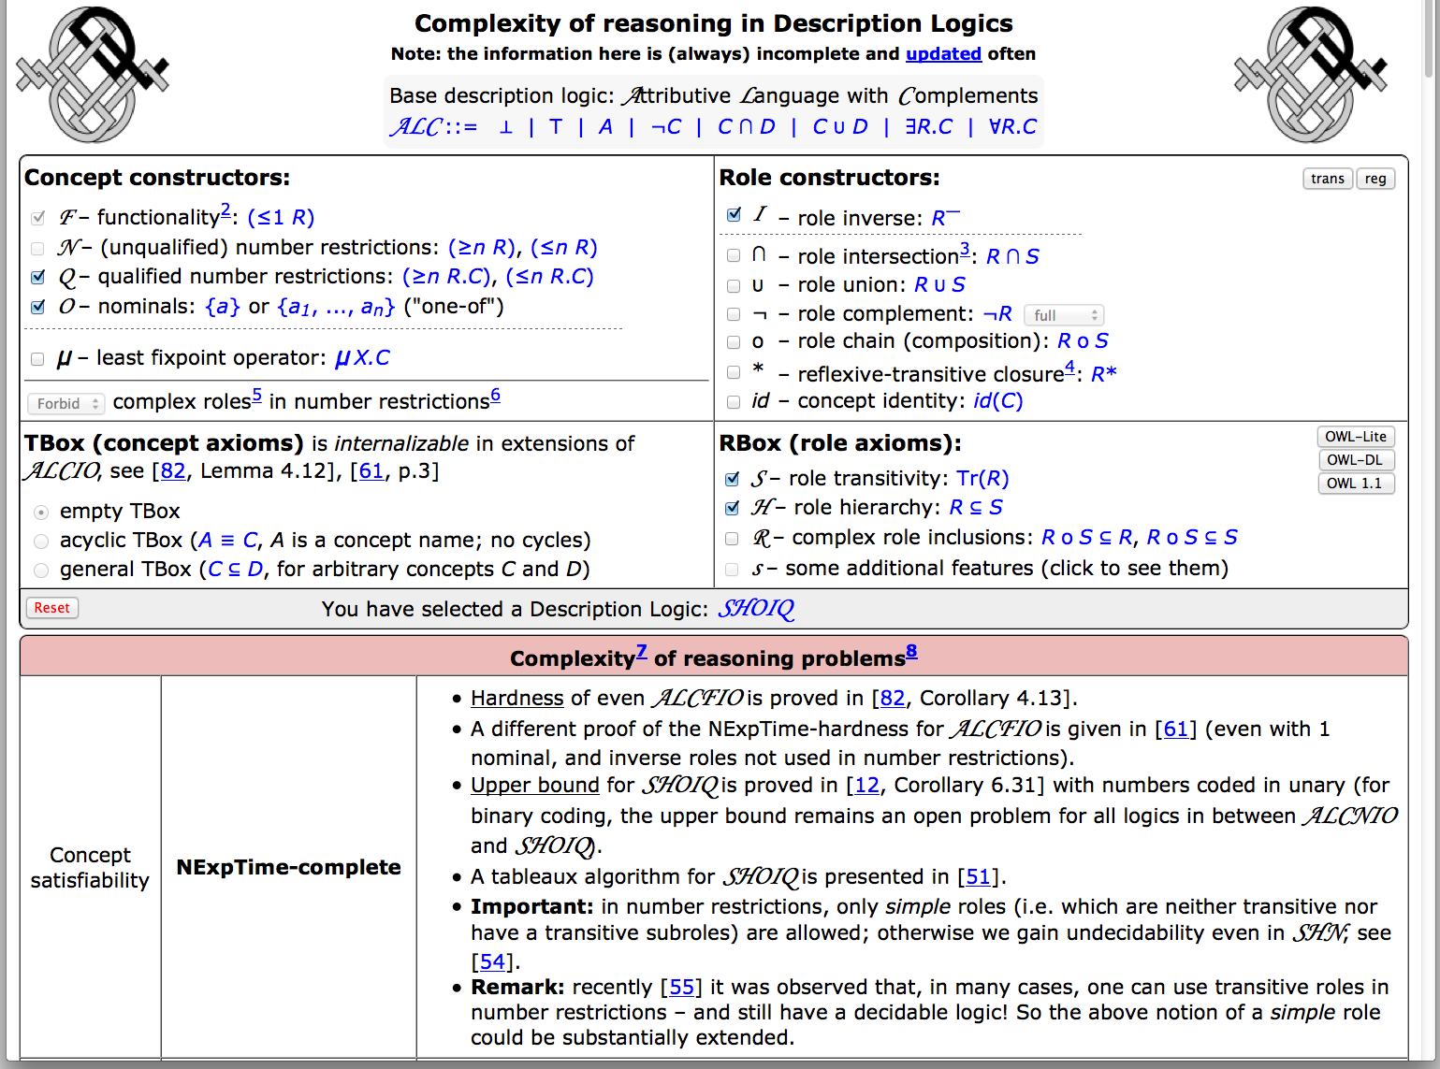
SHOIQ
http://www.cs.man.ac.uk/~ezolin/dl/

Slide 89

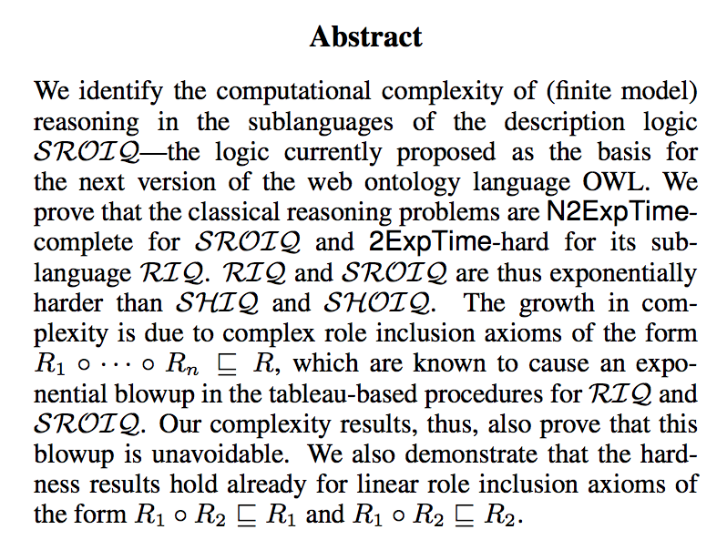

Slide 90
Resources for OWL and DL
Description Logic Handbook, Cambridge University Press
http://books.cambridge.org/0521781760.htm
Description Logic: http://dl.kr.org/
complexity: http://www.cs.man.ac.uk/~ezolin/dl
Web Ontology Language (OWL):
http://www.w3.org/TR/owl2-overview
Reasoners:
Pellet (open source): http://pellet.owldl.com/
FaCT++ (open source): http://owl.man.ac.uk/factplusplus/
Racer (comercial): http://www.racer-systems.com/
(Loom and Powerloom: http://www.isi.edu/isd/LOOM/ )
Ontology Editors:
Protégé: http://protege.stanford.edu/
Ian Horrocks has great slides on description logics and OWL:
http://web.comlab.ox.ac.uk/oucl/work/ian.horrocks/

Slide 91
Additional Slides

Slide 117
Tableaux Inference Algorithms
Reduction to (un)satisfiability.
Idea:
Given knowledge base K
Construct a tree (called Tableau, actually a forest), which represents a model of K.
If attempt fails, K is unsatisfiable.
based on slide from Pascal Hitzler

Slide 118
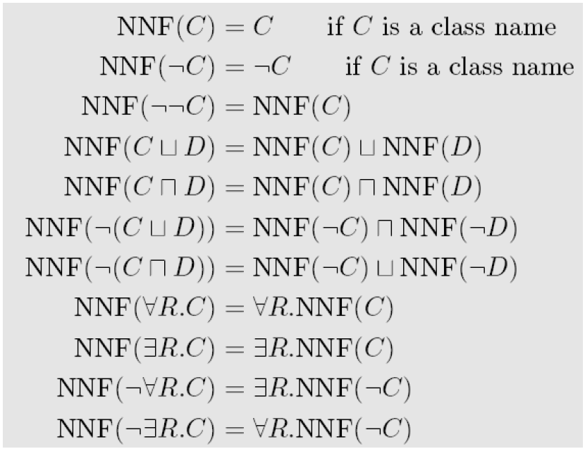
Negation Normal Form
K and NNF(K) have the same models (are logically equivalent).
based on slide from Pascal Hitzler

Slide 119
NNF Example
D ⊑ ( A ⨅ B) ⨆ ¬ (¬ A ⨆ C)
¬D ⨆ ( A ⨅ B) ⨆ ¬ (¬ A ⨆ C)
¬D ⨆ ( A ⨅ B) ⨆ ( A ⨅ ¬ C)
based on slide from Pascal Hitzler

Slide 120
Tableaux rules
based on slide from Pascal Hitzler

Slide 121
Tableaux example 1
KB:
s1: C(a)
s2: C ⊑ ∃R.D
s3: D ⊑ E
Query: Does KB entail (∃R.E)(a) ?
Approach:
Add negation of query: s4: ∀R.¬E(a)
to KB
2. Show unsatisfiability
C (s1)
∃R.D (s2)
a
R
D (s2)
E (s3)
¬E (s4) Contradiction!
x
based on slide from Pascal Hitzler

Slide 122
Tableaux example 2 Reasoning by Cases
KB:
s1: C(a)
s2: C ⊑ ∃R.D
s3: D ⊑ E ⊔ F
s4: F ⊑ E
Query: Does KB entail (∃R.E)(a) ?
Approach:
Add negation of query: s5:∀R.¬E(a)
to KB
2. Show unsatisfiability
C (s1)
∃R.D (s2)
a
D (s2)
¬E (s5)
Choice: D ⊑ E ⊔ F (s3)
1. E Contradiction!
2. F
E (s4) Contradiction!
R
x
based on slide from Pascal Hitzler

Slide 124
Termination
New blocking rules to ensure termination
See Ian Horrocks slides

Slide 125
[slide by Ian Horrocks]

Slide 126
[slide by Ian Horrocks]

Slide 127
[slide by Ian Horrocks]

Slide 128
[slide by Ian Horrocks]

Slide 129
[slide by Ian Horrocks]

Slide 130
[slide by Ian Horrocks]

Slide 131
[slide by Ian Horrocks]

Slide 132
[slide by Ian Horrocks]

Slide 133
[slide by Ian Horrocks]

Slide 134
[slide by Ian Horrocks]

Slide 135
[slide by Ian Horrocks]

Slide 136
[slide by Ian Horrocks]

Slide 137
[slide by Ian Horrocks]

Slide 138
[slide by Ian Horrocks]

Slide 139
[slide by Ian Horrocks]

Slide 140
[slide by Ian Horrocks]

Slide 141
[slide by Ian Horrocks]

Slide 143
[slide by Ian Horrocks]

Slide 144
[slide by Ian Horrocks]

Slide 145
[slide by Ian Horrocks]

Slide 146
[slide by Ian Horrocks]

Slide 147
[slide by Ian Horrocks]

Slide 148
[slide by Ian Horrocks]

Slide 149
[slide by Ian Horrocks]

Slide 150
[slide by Ian Horrocks]

Slide 151
ALC

Slide 152
SHOIQ
http://www.cs.man.ac.uk/~ezolin/dl/

Slide 153
Resources for OWL and DL
Description Logic Handbook, Cambridge University Press
http://books.cambridge.org/0521781760.htm
Description Logic: http://dl.kr.org/
complexity: http://www.cs.man.ac.uk/~ezolin/dl
Web Ontology Language (OWL):
http://www.w3.org/TR/owl2-overview
Reasoners:
Pellet (open source): http://pellet.owldl.com/
FaCT++ (open source): http://owl.man.ac.uk/factplusplus/
Racer (comercial): http://www.racer-systems.com/
(Loom and Powerloom: http://www.isi.edu/isd/LOOM/ )
Ontology Editors:
Protégé: http://protege.stanford.edu/
Ian Horrocks has great slides on description logics and OWL:
http://web.comlab.ox.ac.uk/oucl/work/ian.horrocks/

